Slide 1
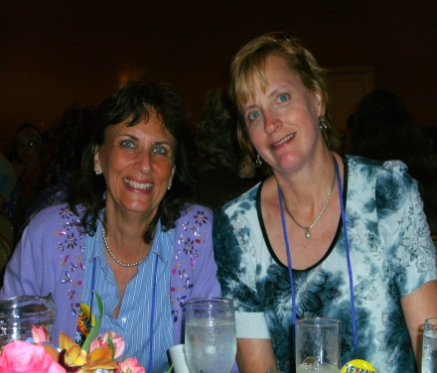
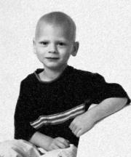
Welcome to Research4Life aka
Exciting Elementary Library Lessons
Valerie Price, Spring ISD
Beneke Elementary, part-time
Leslie Clingan, El Paso ISD
H.R. Moye Elementary, full-time
Bachelor of Science in Education, UTK, 1981
Master’s in Reading, U of H, 1990
Library certification, UNT, 2008
Librarian for 4 years
Title I campus, 800 students,
LEP – Spanish and Vietnamese
Bachelor of Science in Art Education, UTK, 1979
Master’s of Library and Information Science, UNT, 2008
Librarian for 23 years – I needed job, they needed librarians
Title I campus, 750 students
Everyone’s LEP

Slide 2
Presentation Goals
Participants will have something they can take away from workshop and put into use this year
Sharing ideas for making librarians more visible and vital
Provide activities that encourage collaboration between classroom and library
Introduce Google Voice questions.
Offer useful resources for library lesson ideas and useful resources for student research.

Slide 3
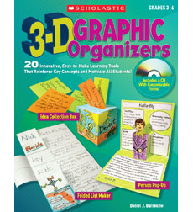



3D Graphic Organizers by Daniel J. Barnekow
Library Research with Emergent Reader by
Christa Harker and Dorette Putonti
Mentor Texts:
Teaching Writing through
Children’s Literature
AND
Mentor Texts: Teaching Informational Writing through Children’s Literature both by Lynne
Dorfman and
Rose Cappelli

Slide 4
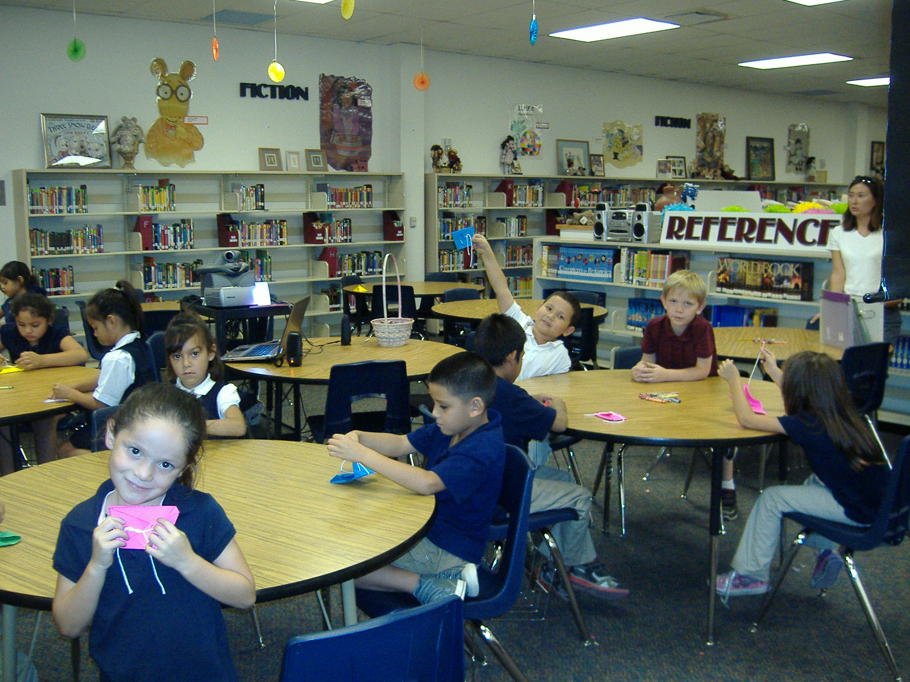
Making origami diapers for ‘Books are Like Babies’ library orientation.

Slide 5
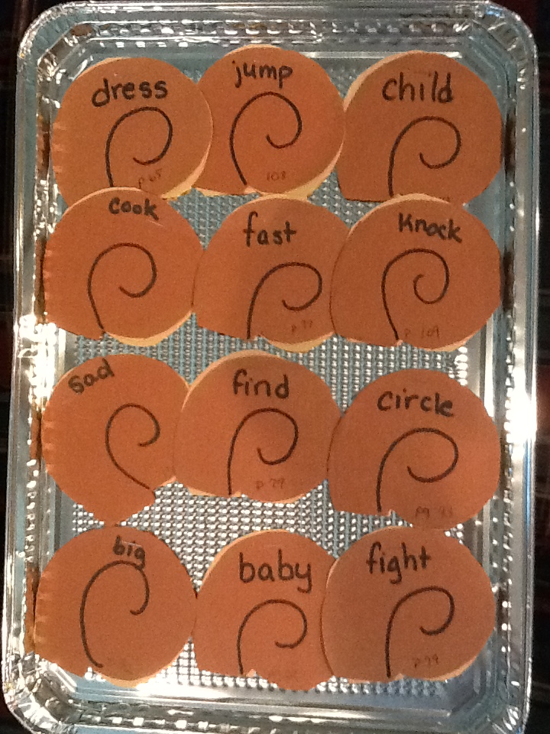
Synonym Rolls
Synonym Rolls

Slide 6
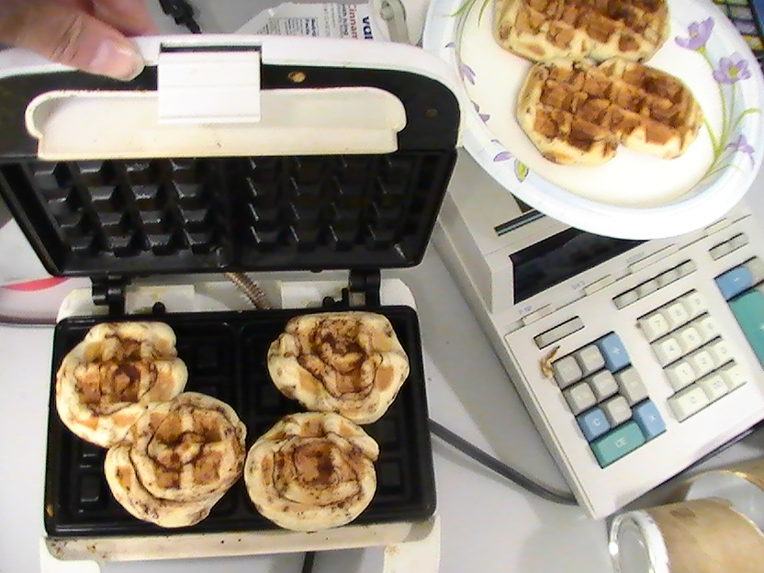
Making Synonym Rolls

Slide 7
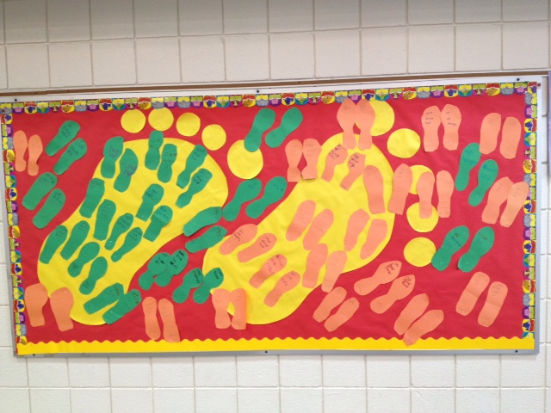
The Foot Book Antonyms

Slide 8
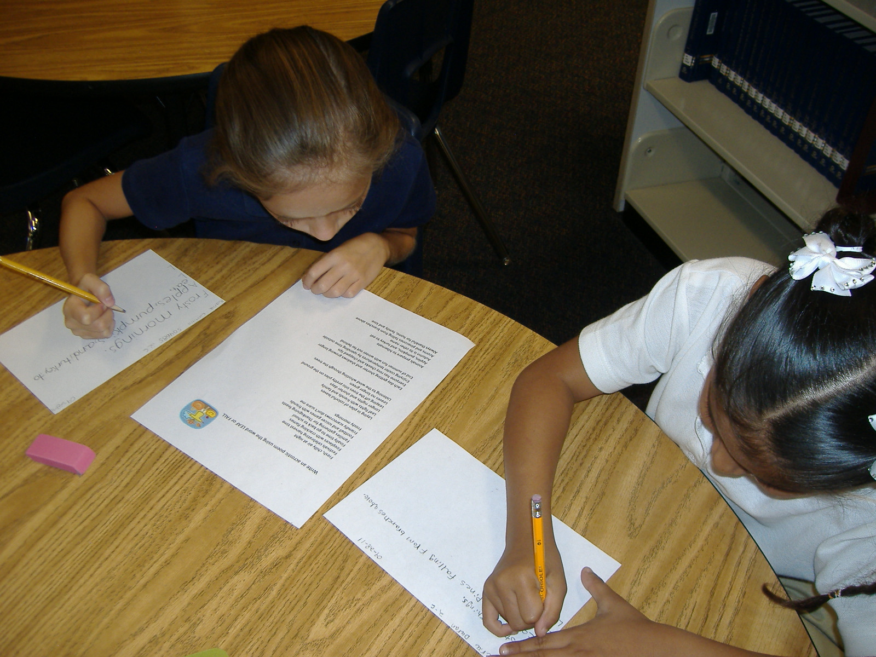
Writing acrostic poems made easy.

Slide 9
Write an acrostic poem using the word LEAF or FALL
Fresh, chilly air at night
Festivals celebrating harvest time
Fireplaces with crackling flames
Finally time to go back to school
Families gathering for Thanksgiving feasts
Football and soccer games with friends
Friendly scarecrows don’t scare me
Frosty mornings
Laying in piles of colorful leaves
Leaf fights with friends and family
Longer nights and shorter days
Leaping off the trees into pretty piles on the ground
Leaves no longer green
Listening to the wind whistling through the trees
Each day getting shorter and shadows growing longer
Everyone has rosy cheeks and chapped lips
Enjoying cooler temperatures by spending time outside
End of summer fun with winter not far behind
Animals prepare to hibernate
Apples, pumpkins, and turkey to eat
Autumn is its other name
Acorns and pinecones falling from branches above
Always thankful for home, family and love

Slide 10
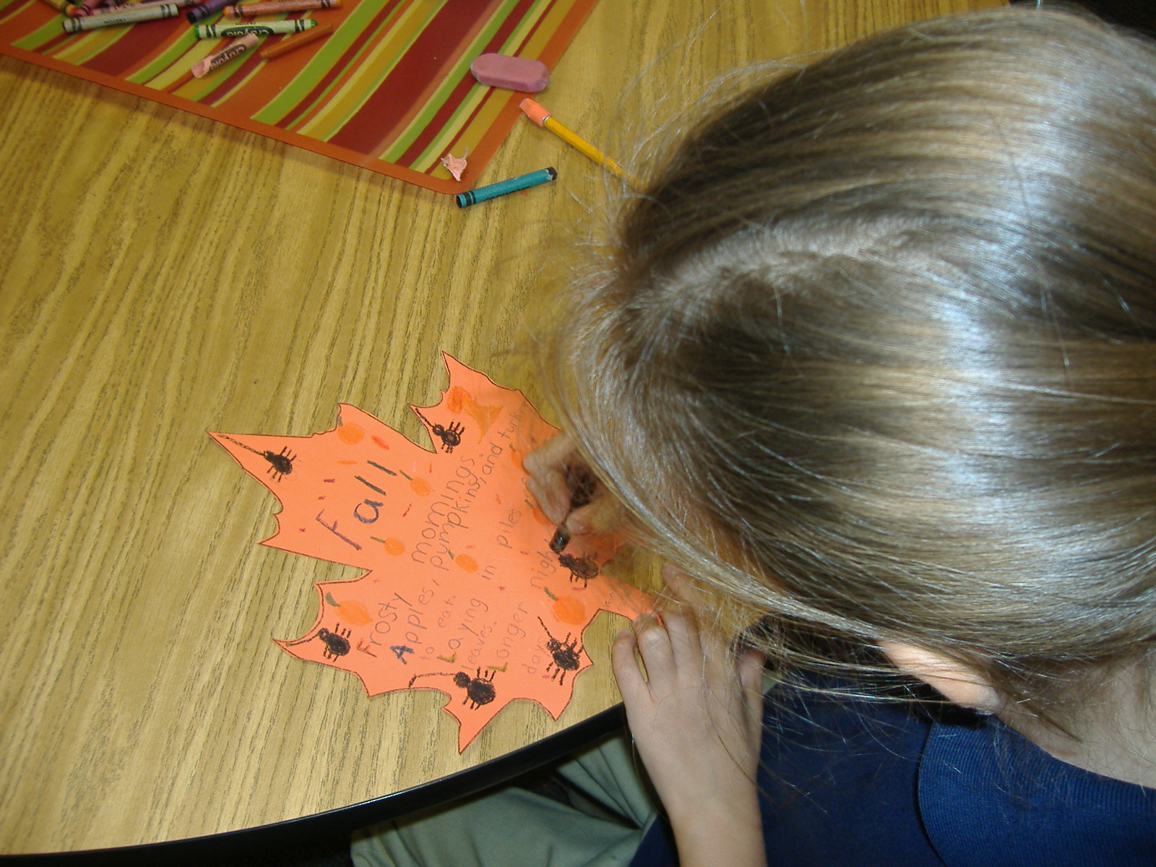
Kiana’s acrostic poem.

Slide 11
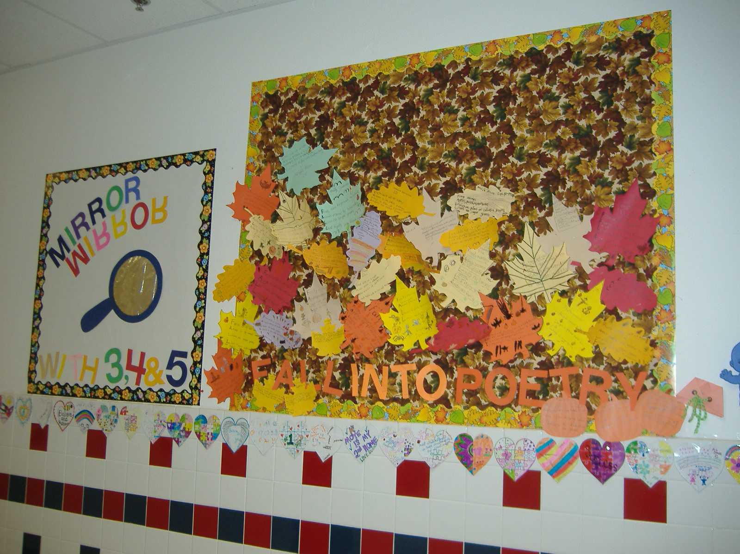
Acrostic poems on display.

Slide 12


Concrete Poems
A concrete poem is one that takes the shape of the object it describes.
Check out the website Tagxedo at http://www.tagxedo.com/gallery.html

Slide 13
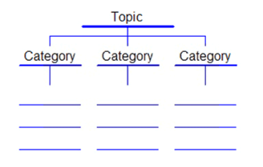
Founding Fathers Tree Map

Slide 14
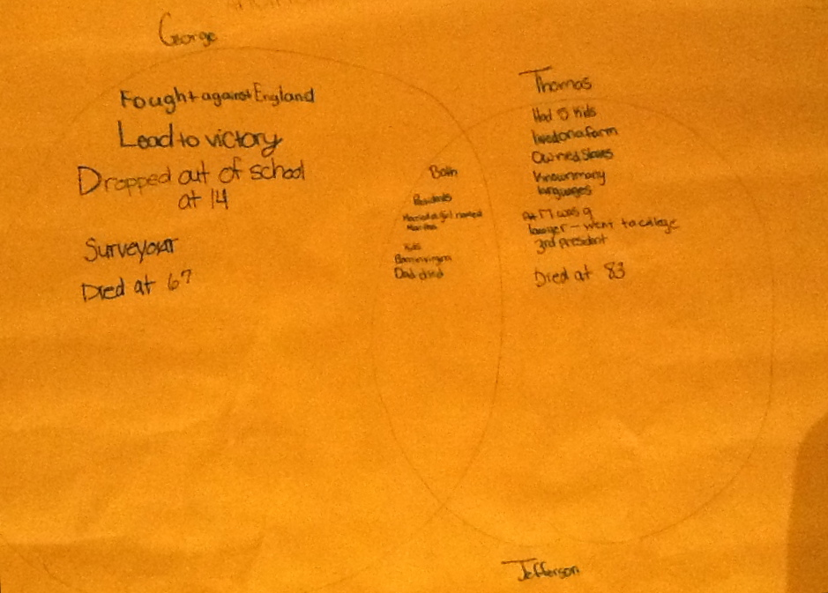
Founding Fathers Venn Diagram

Slide 15
Biography Interview Worksheet
Name: __________________________________ Date: ____________________________
Biography Interview Worksheet
Name: ________________________________________________________ Age: ________ Birthday: _______________
Where do you live: __________________________________________________________________________________
Parents’ names: ____________________________________________________________________________________
Names of brothers and sisters: ________________________________________________________________________
__________________________________________________________________________________________________
What is your favorite stuffed animal or toy? ______________________________________________________________
What is your favorite subject in school? _________________________________________________________________
What are you going to be when you grow up? ____________________________________________________________
Do you have a pet? If so, what kind of pet and what is its name? ______________________________________________
__________________________________________________________________________________________________
What is your favorite thing to do on the weekends? ________________________________________________________
__________________________________________________________________________________________________
What is your favorite color? ___________________________________________________________________________
What is your favorite food? ___________________________________________________________________________
What is the title of a book you have read and liked this year? ________________________________________________
__________________________________________________________________________________________________
Who was the main character of that book? _______________________________________________________________
What is something special about you? __________________________________________________________________
__________________________________________________________________________________________________
Who is your hero and why? ___________________________________________________________________________
__________________________________________________________________________________________________

Slide 16
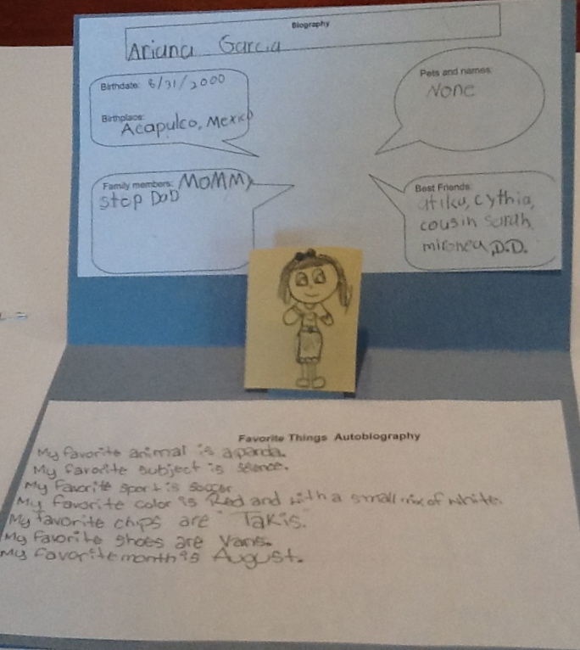
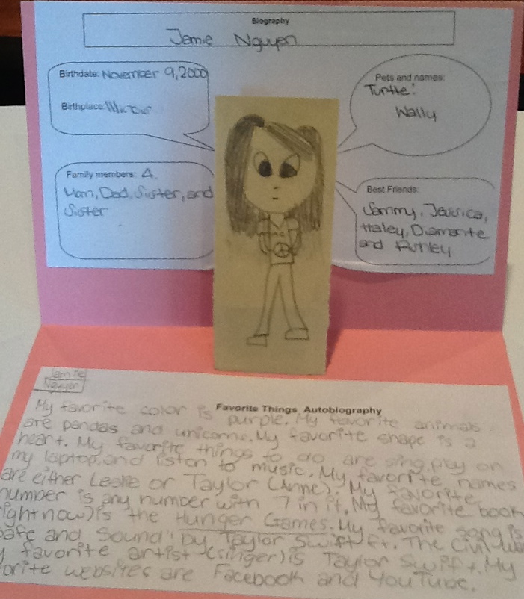
Biography and Autobiography
Pop-Ups

Slide 17
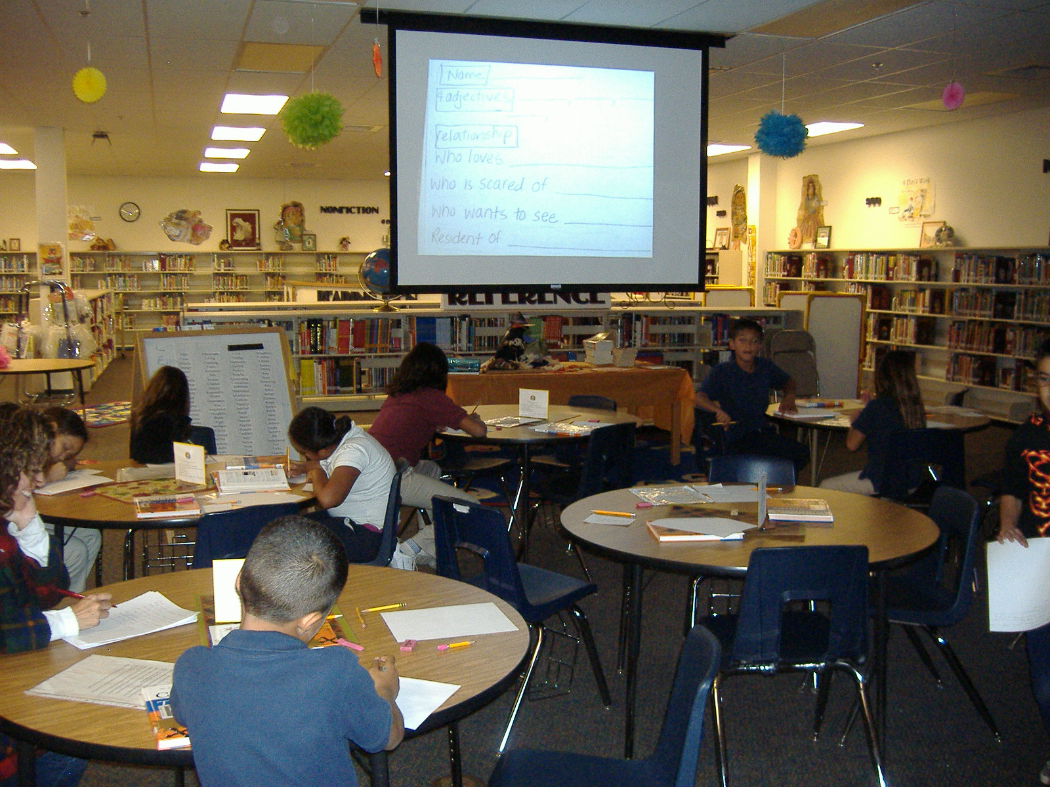
Reading Bluebonnet biographies and writing autobiographical persona poems.

Slide 18

Biographical Information
List of Titles
Author / Illustrator Name
Book Summary
Awards
Using the Mackin Booktalk site via TxLA, students looked up their favorite Bluebonnet book and completed this worksheet about the book and its author.

Slide 19
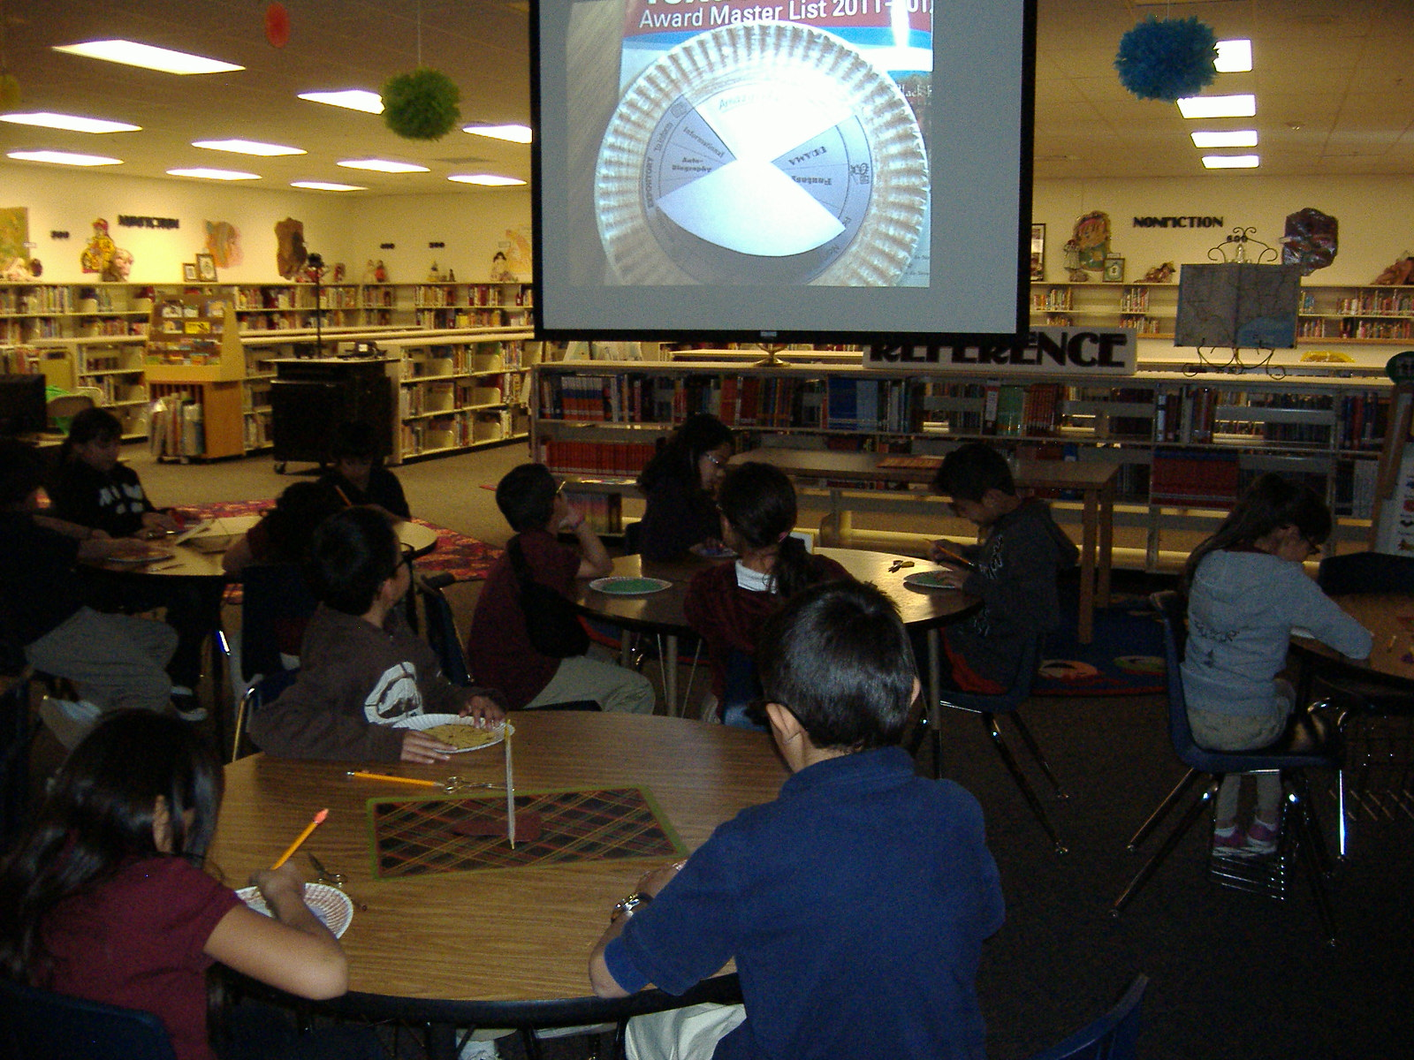
Serving up genre pie with the books on the Bluebonnet Master List.

Slide 20
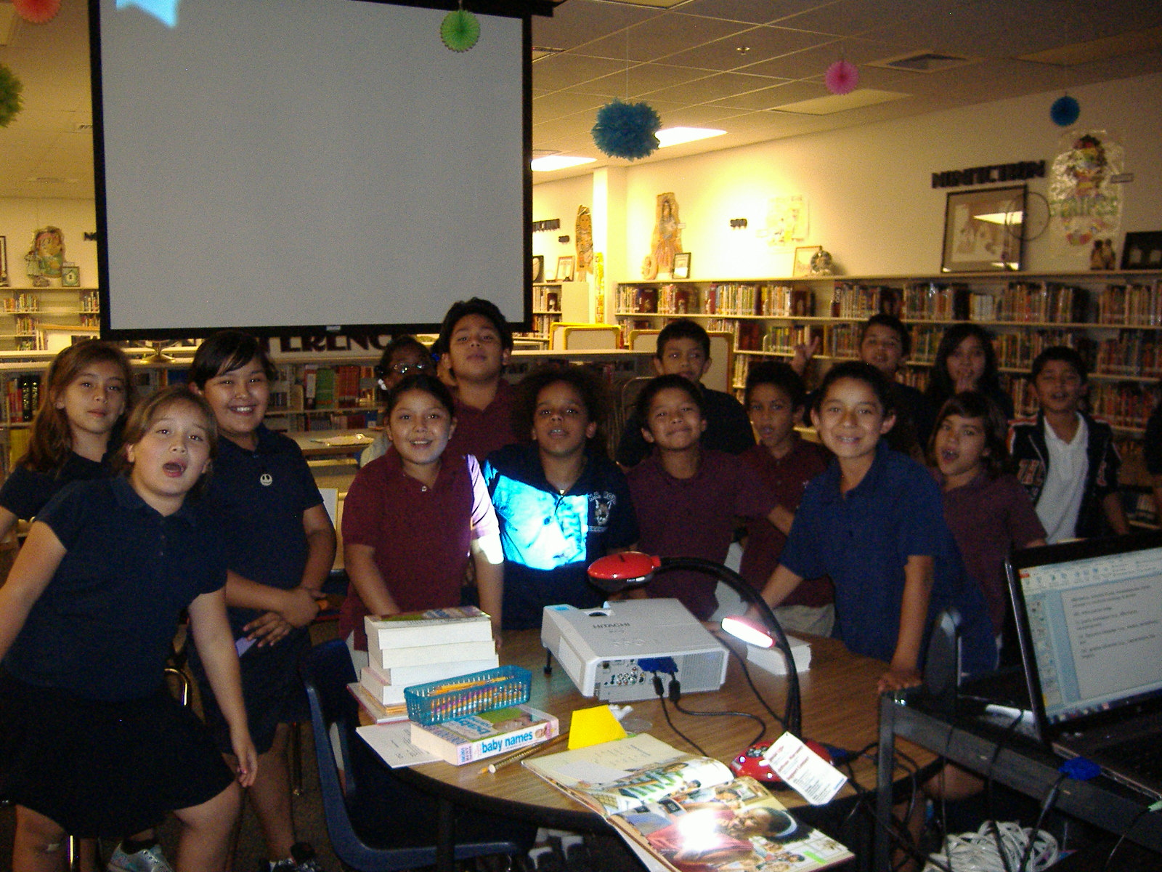
Choral poetry reading with the poetry books from the Bluebonnet Master List.

Slide 21
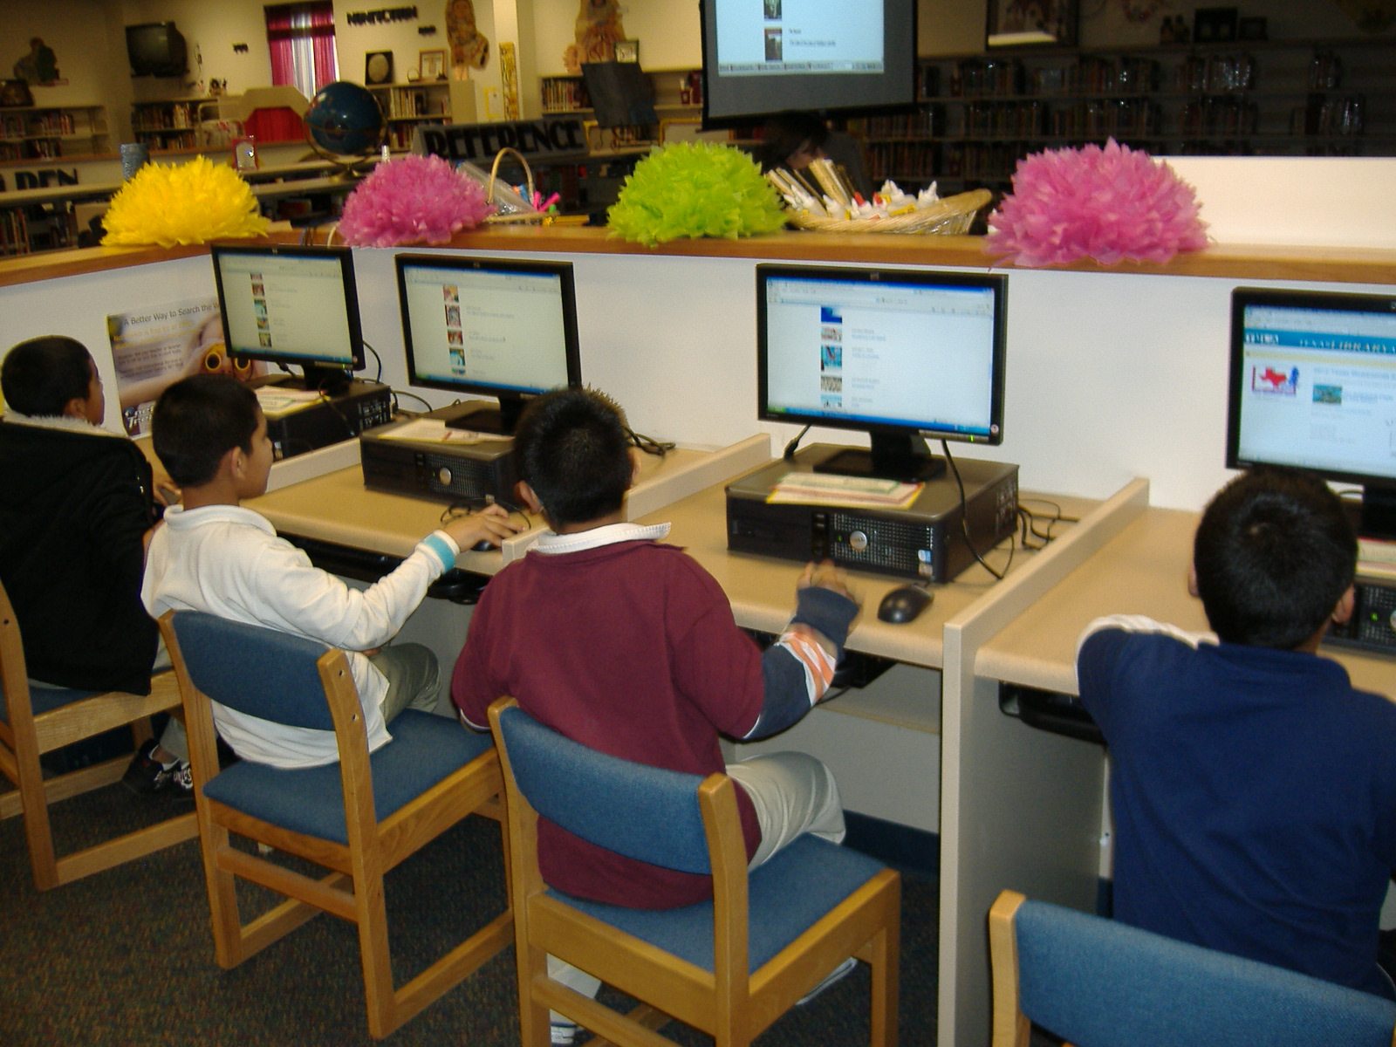
Then voting online for our favorite Bluebonnet book.

Slide 22
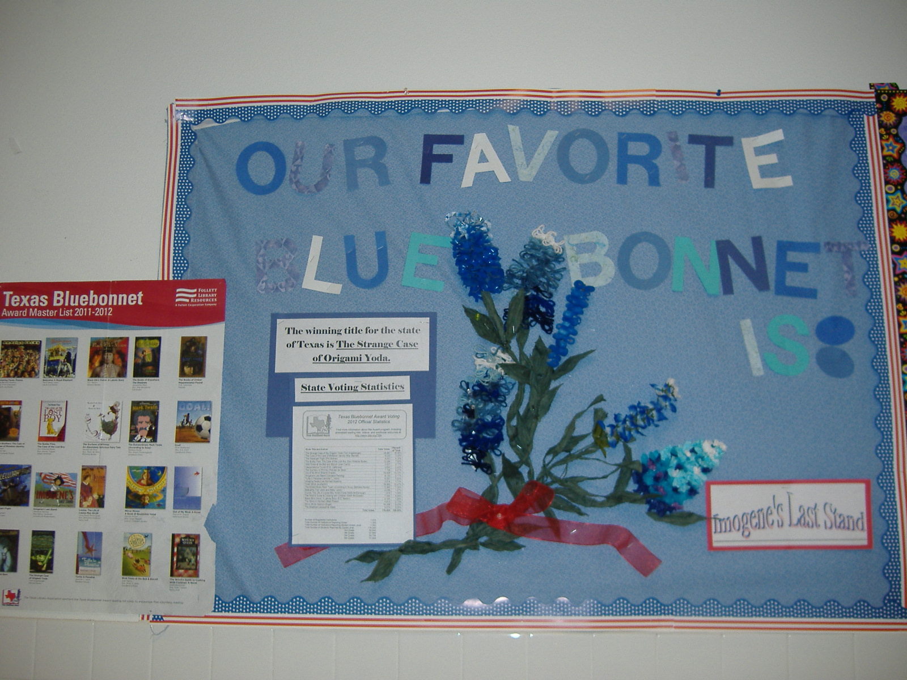
Imogene’s Last Stand won by a landslide at Moye.

Slide 23
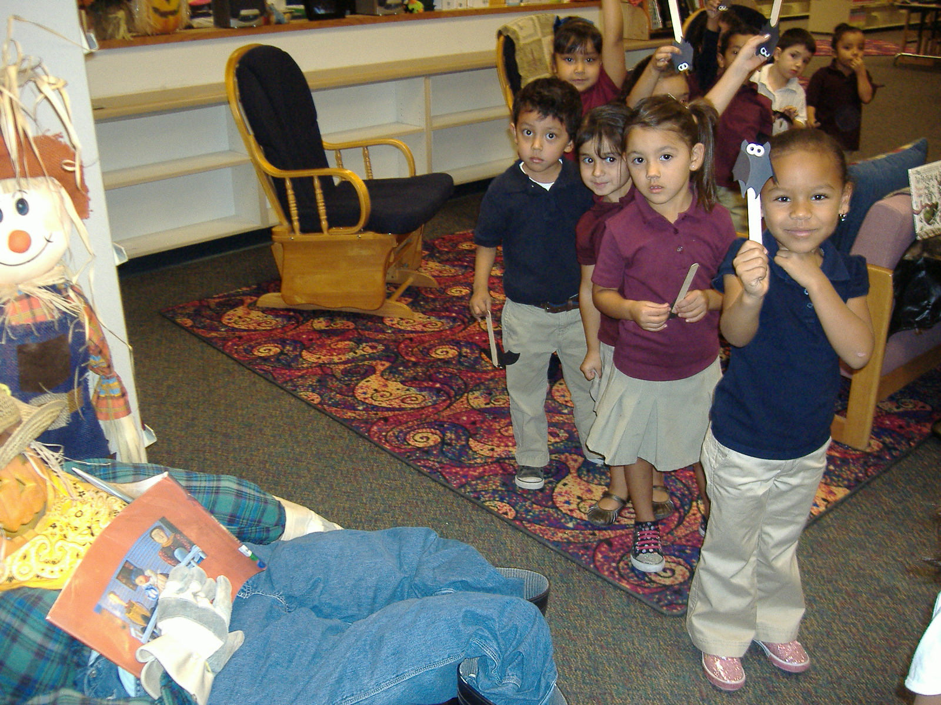
Batty about bats.

Slide 24
First Grade is Batty about Bats
Research by:
_________________________________
A bat is a:
mammal
reptile
amphibian
bird
Just like us, baby bats drink milk from their mother’s body. When they get older they eat other things. Draw a picture of what bats eat in the box.
How many legs and feet does the bat have?
0 2 4 6 8
A bat’s body has:
hair or fur
scales
feathers
fins
Bats have ________ fingers that are part of their wings.

Slide 25
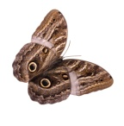




Bats make high beeping noises that we can not hear. The beeps go out in waves and hit things around the bat. When the sounds hit something they bounce back to the bat as an echo. The echo tells the bat what is around him. The bats ears work like _____________. Draw the beeps the bat makes in green and draw the echoes in red.
Draw a bat sleeping in a cave.
When do bats sleep? Circle your answer.
The title of the book I used is:
_________________________________
_________________________________
Bats use _________________ on their toes and thumbs to hang upside down.

Slide 26
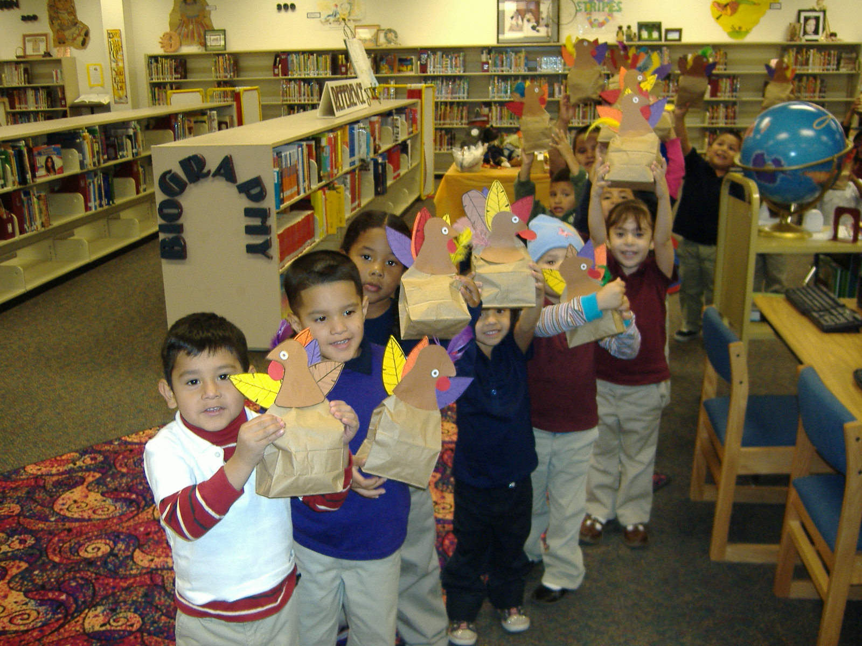
Thanksgiving turkeys and community helpers.

Slide 27


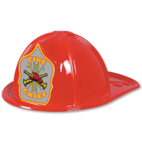
Community Helpers
What telephone number can you dial on the phone when you or your family has an emergency? Put the numbers in the boxes below.
Who does your community helper help?
YES NO
Adults
Children
Animals
Draw a picture of your community helper in his or her uniform.
Draw a picture of some of the tools your helper uses.

Slide 28
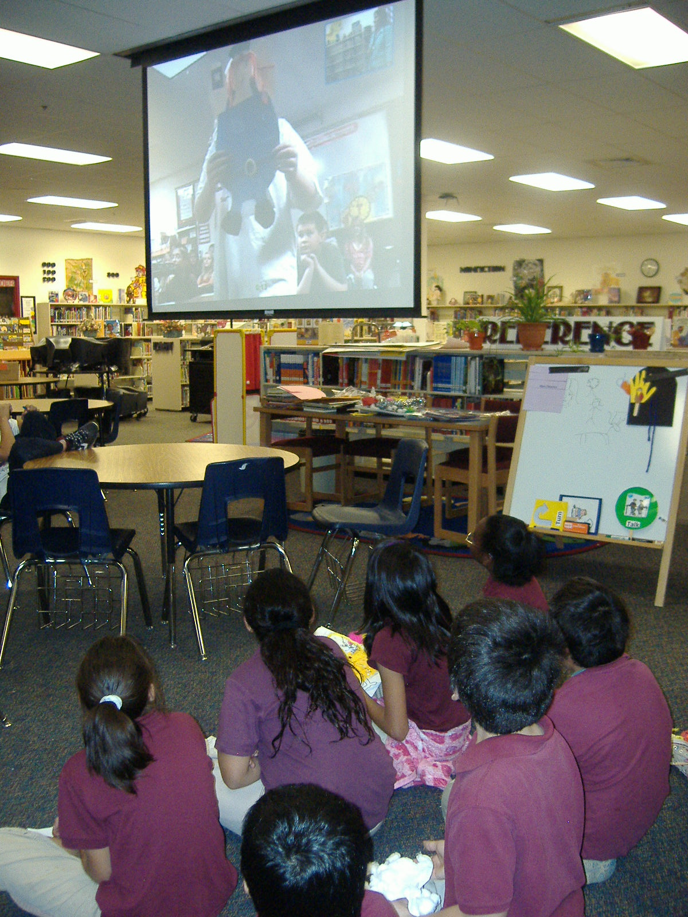
A Plump and Perky Turkey video conference – book by Teresa Bateman, turkeys by Moye students. http://projects.twice.cc/ and http://www.cilc.org/

Slide 29
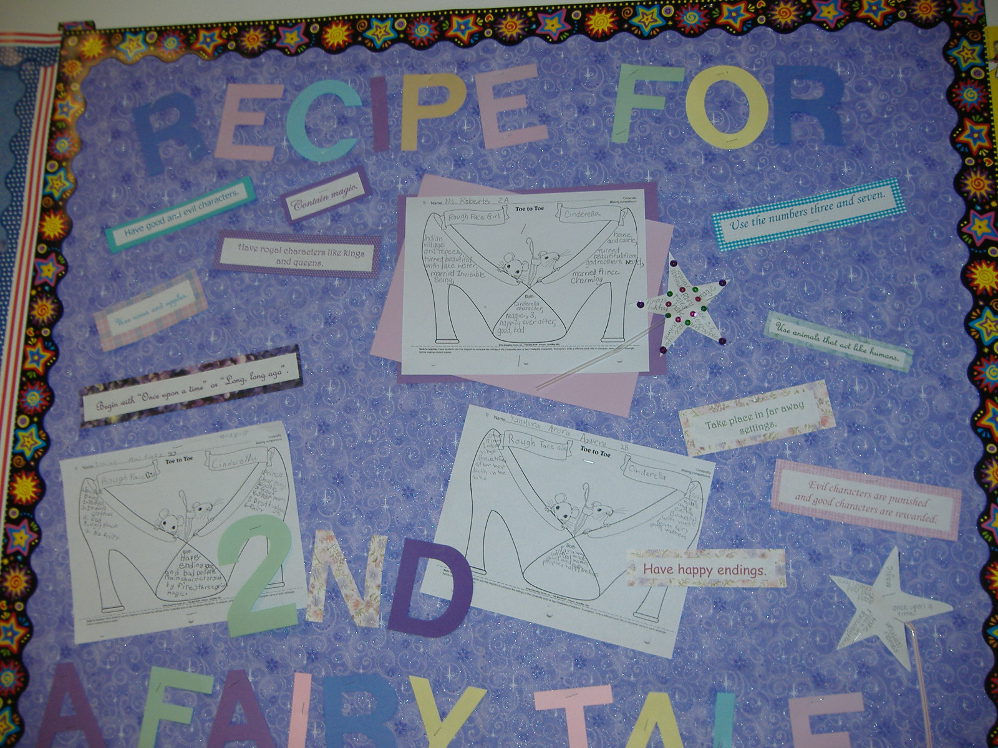
Comparing versions of the Cinderella story while learning the characteristics of a fairy tale.

Slide 30
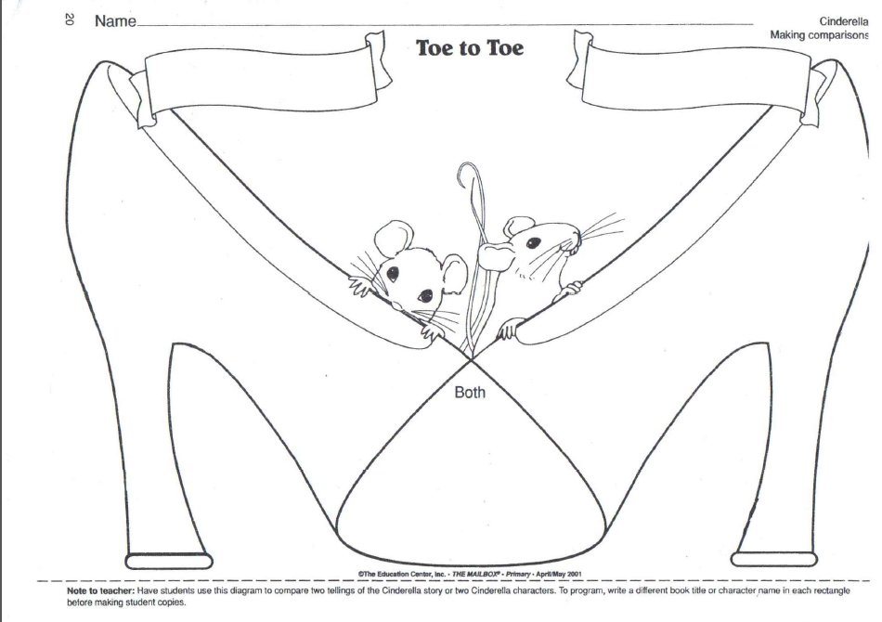

Slide 31
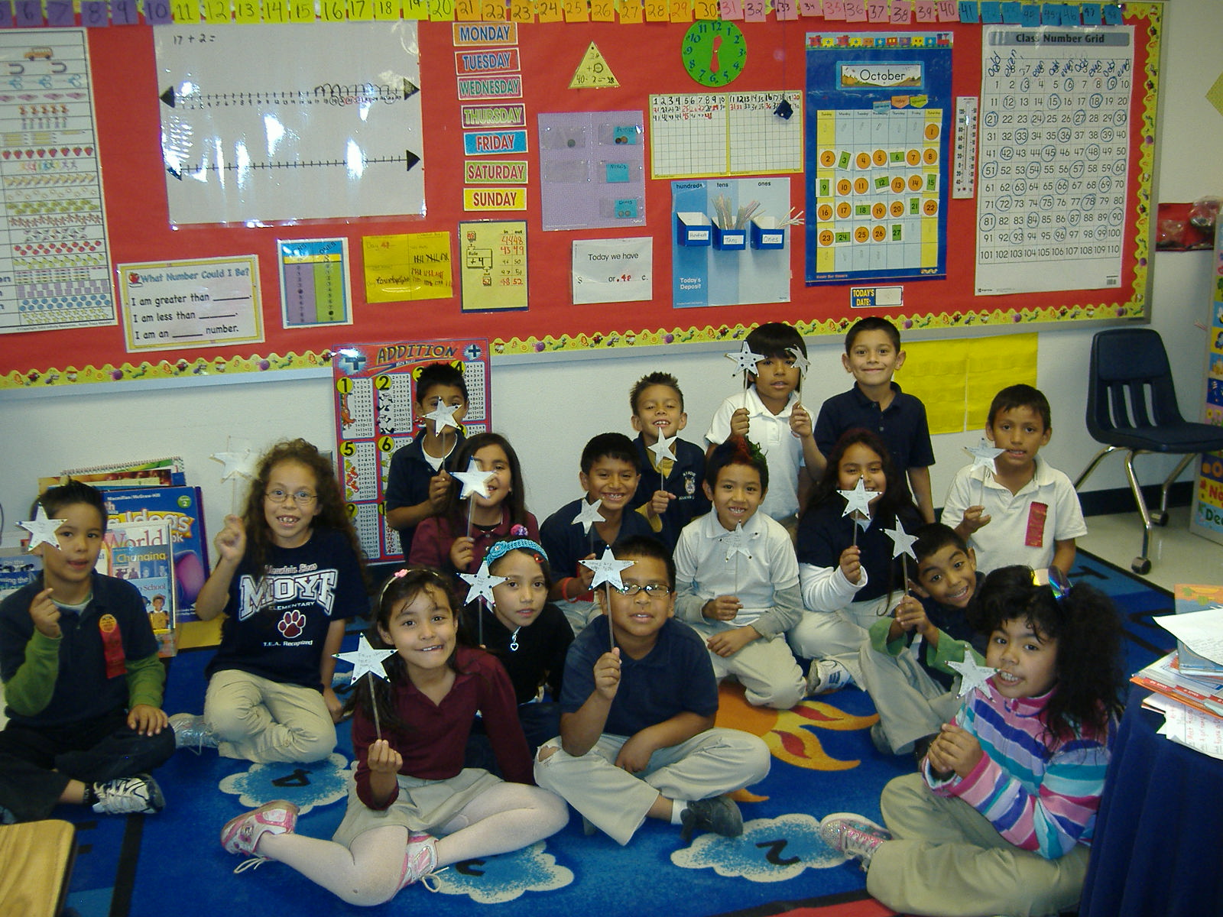
Sprinkling magic into our study of fairy tales.

Slide 32
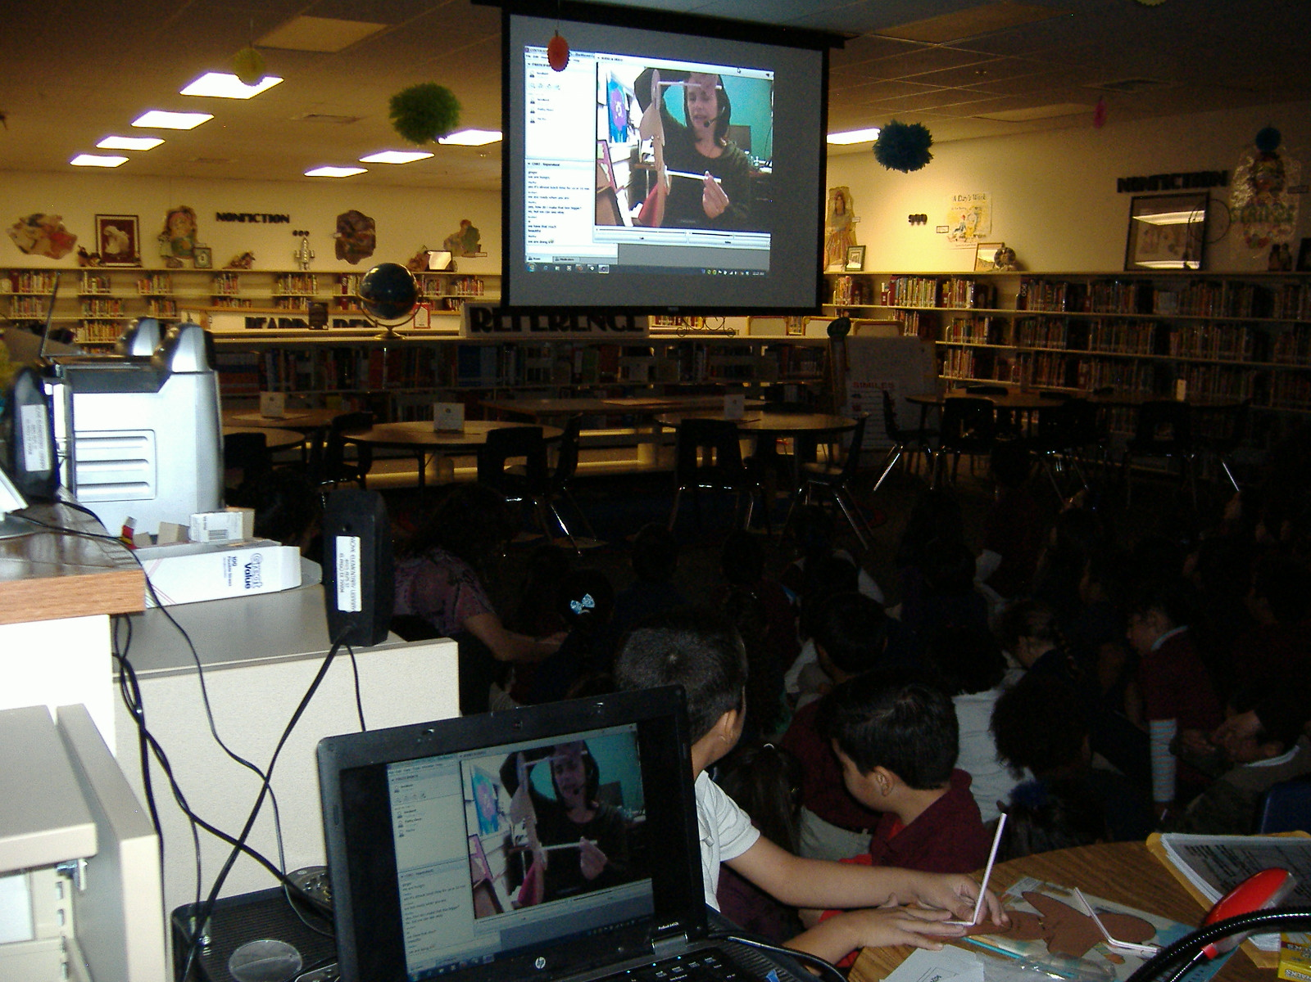
Virtual field trip to Center for Puppetry Arts concludes our study of folktales. http://projects.twice.cc/ and http://www.cilc.org/

Slide 33
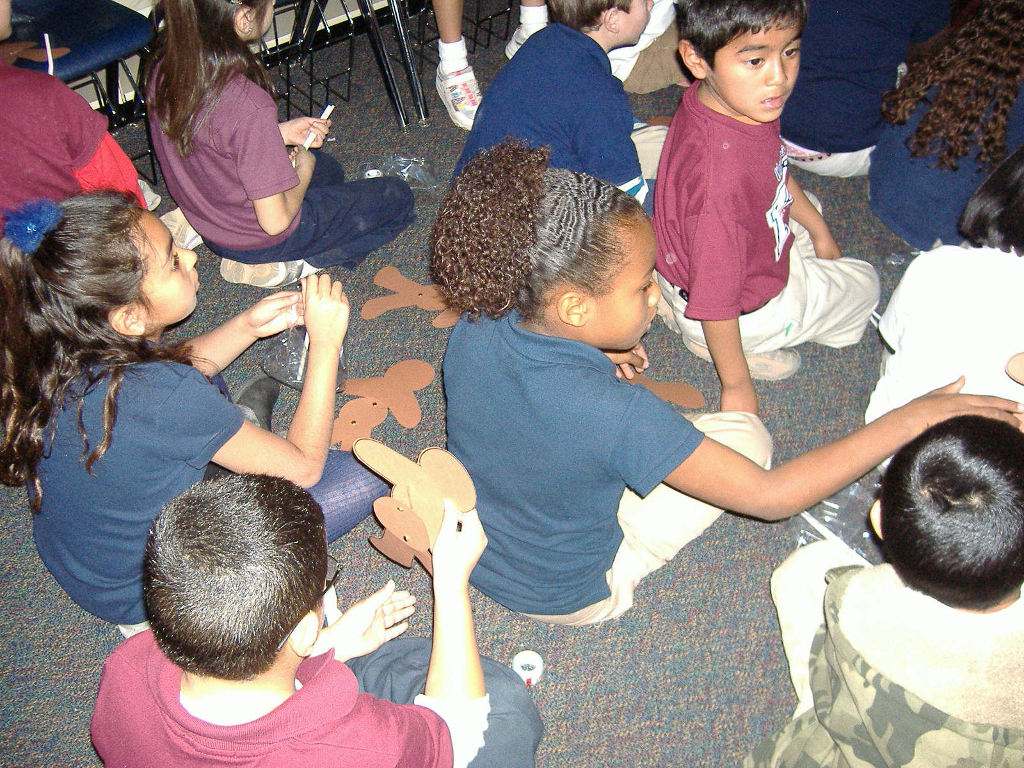
Making our own gingerbread man puppets so we can pass along this folktale to someone we love.

Slide 34

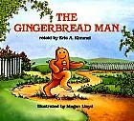

“Gingerbread Man” worksheet
Name: ________________________________________________________________ Class: __________ Date: ________________________
Story | Characters and Setting | Repeated Phrase | Ending

Slide 35
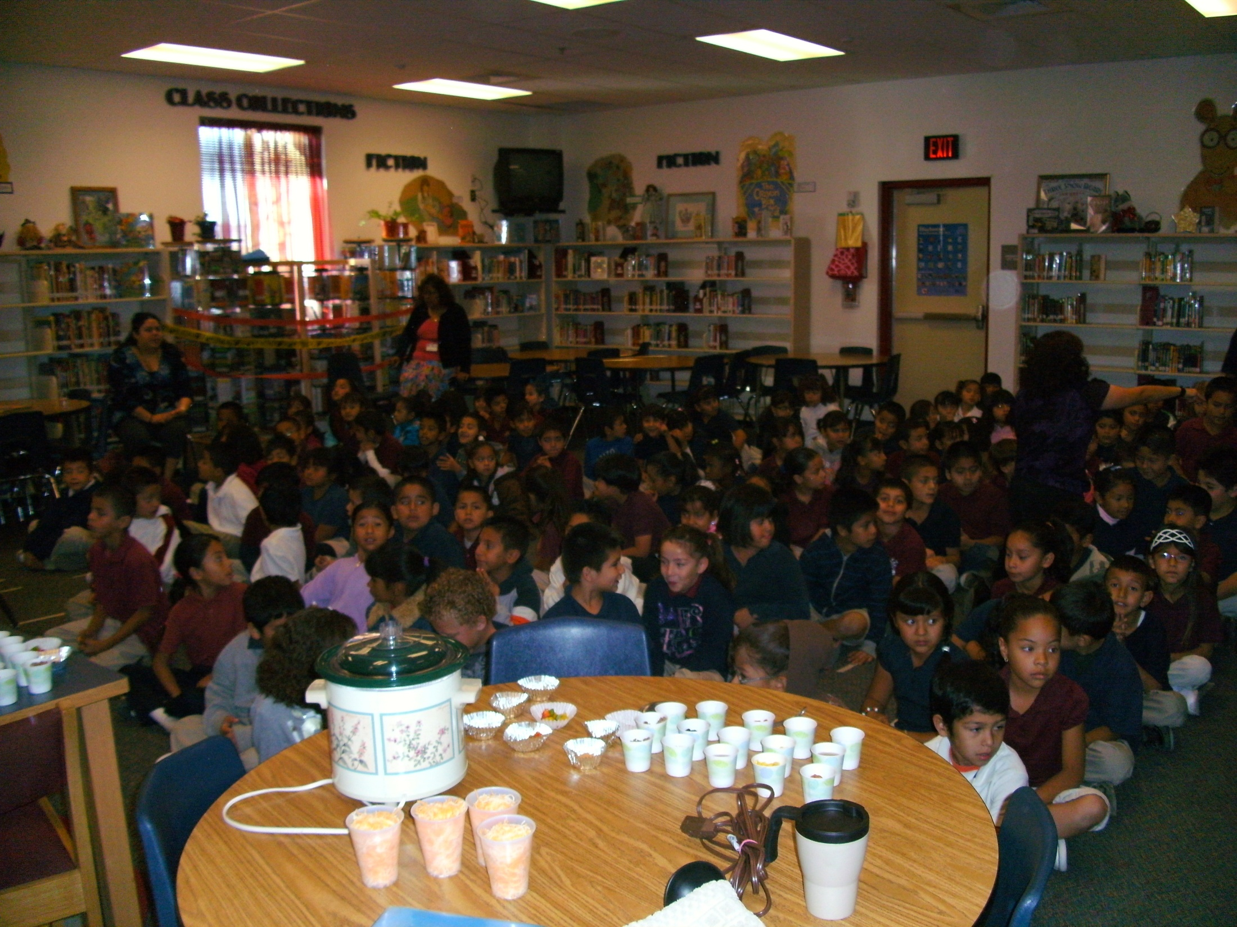
Preparing stone soup with a hundred hungry second graders.

Slide 36
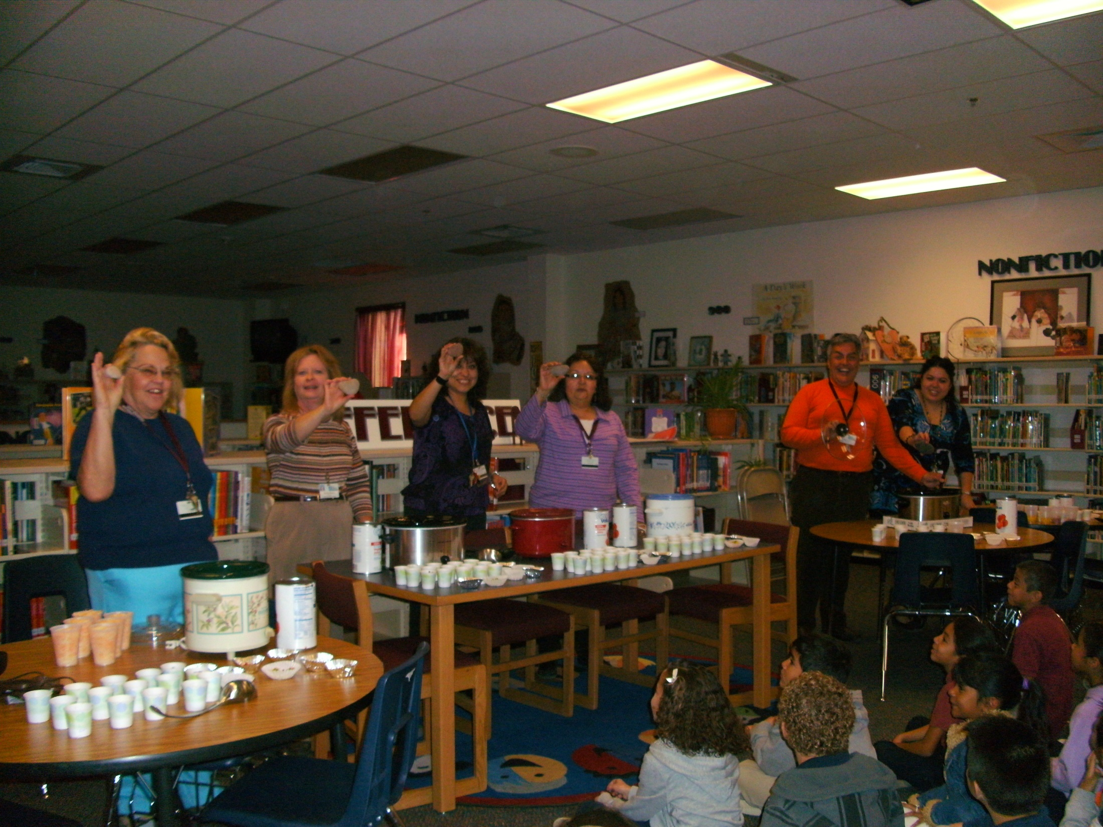
The teachers added the stones.
Everyone added an ingredient. Our dad even got into the action.

Slide 37
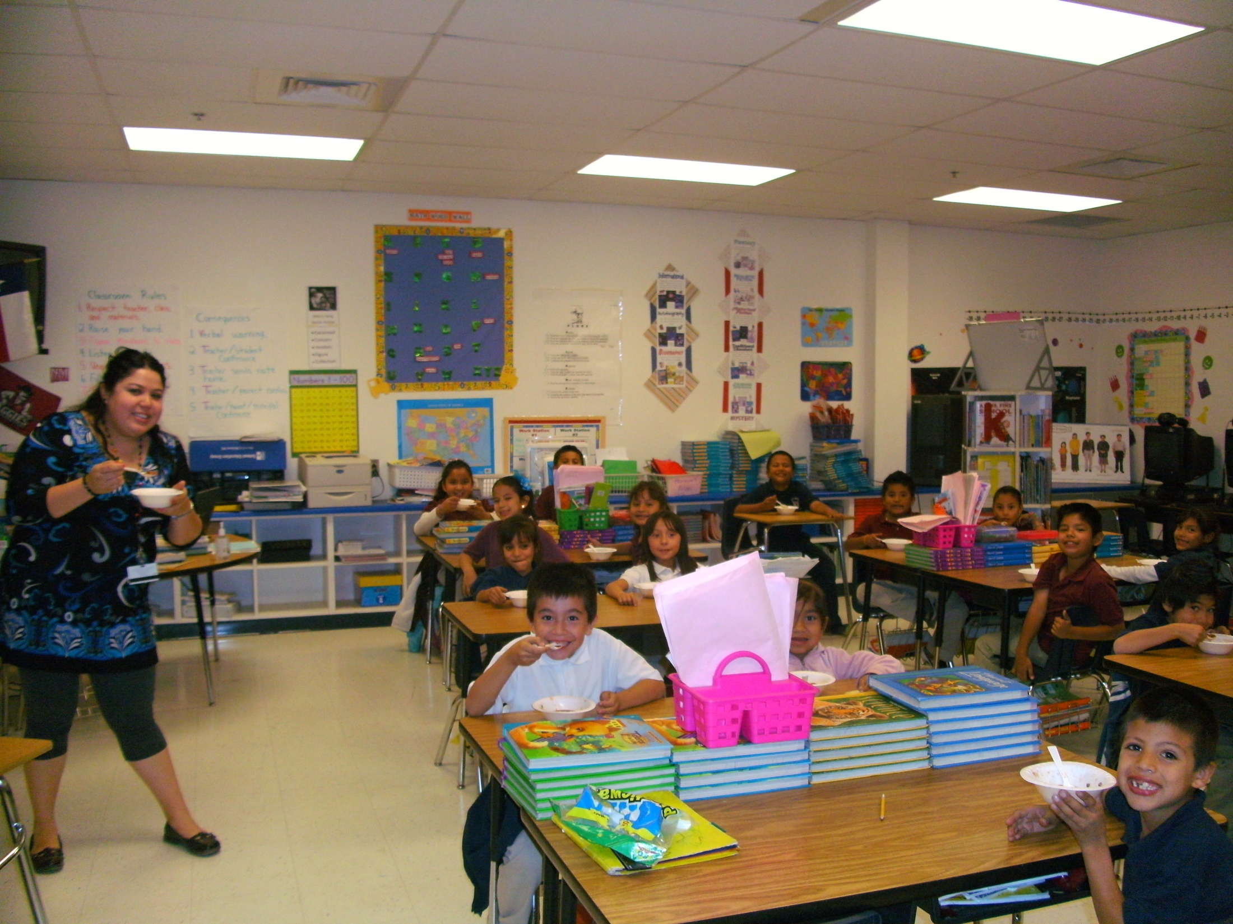
We are really great cooks!

Slide 38
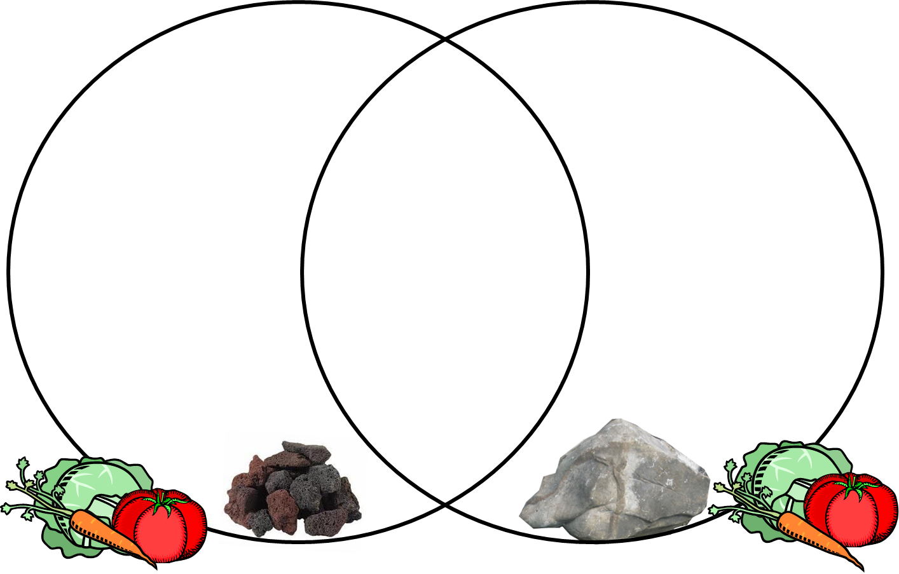
Stone Soup Venn Diagram

Slide 39
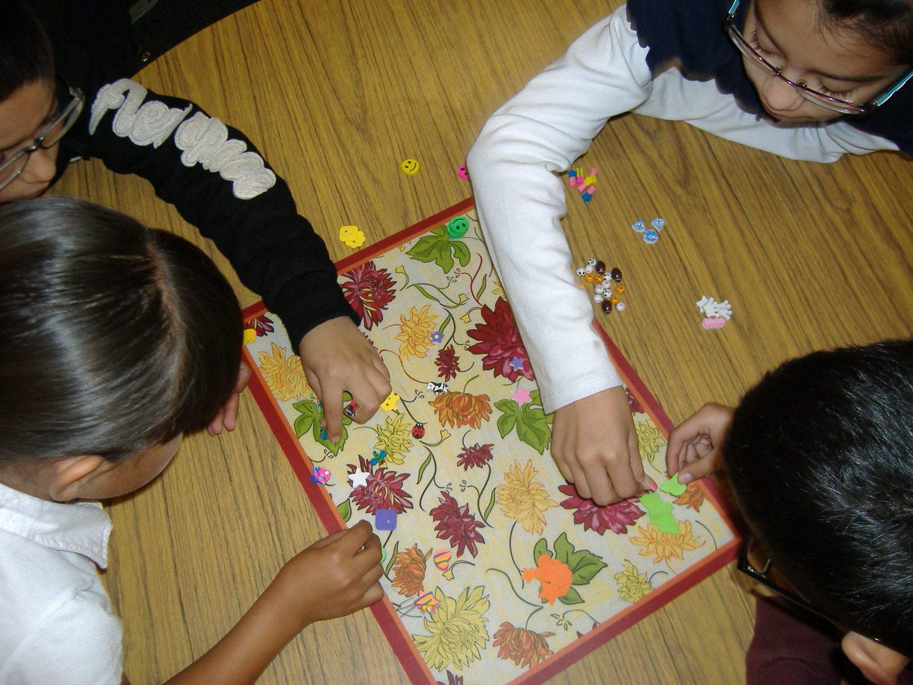
Understanding Dewey by sorting objects to represent the classification system.

Slide 40
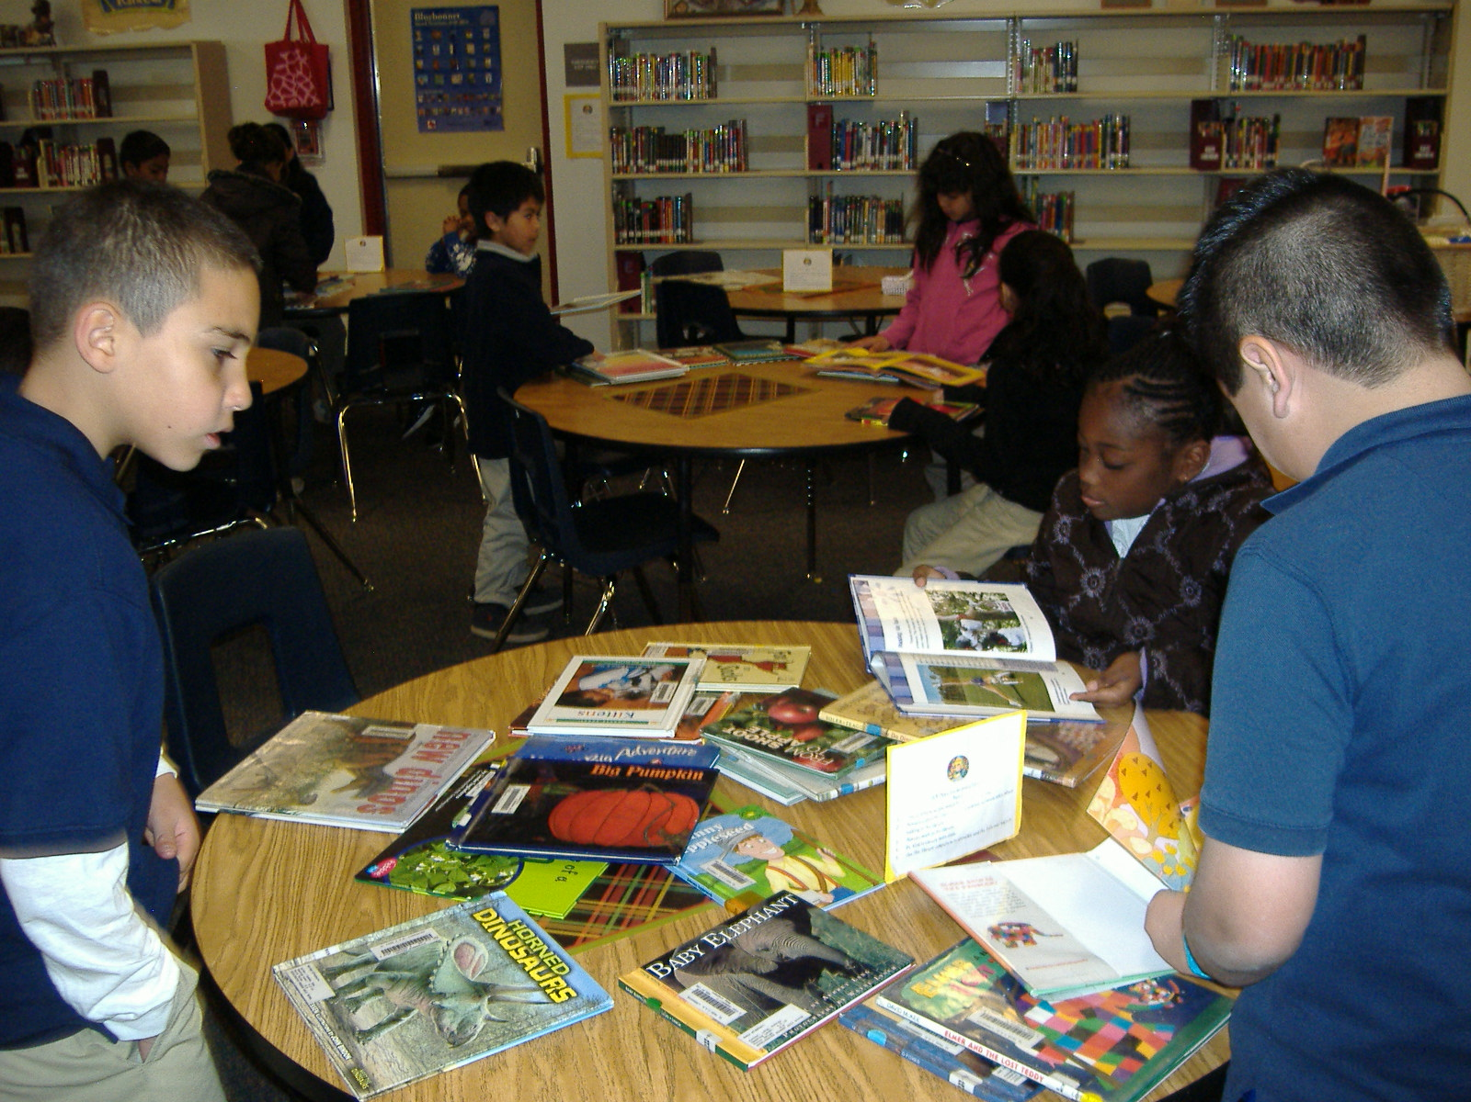
Then practicing Dewey with books!

Slide 41


Pumpkin Jack
During what season do we buy pumpkins and carve them into jack-o-lanterns? Circle your answer.
Fall
Winter
Spring
Summer
When Tim’s jack-o-lantern begins to rot, he puts it in the garden with the dead plants. Draw a picture of how the jack-o-lantern looks once it starts rotting.
Underline the words that describe how the jack-o-lantern looked when it started to rot.
Faded Crumpled Round
Flat Wrinkled Fat
Bright Orange Brown
Gray

Slide 42
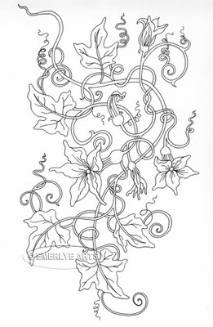
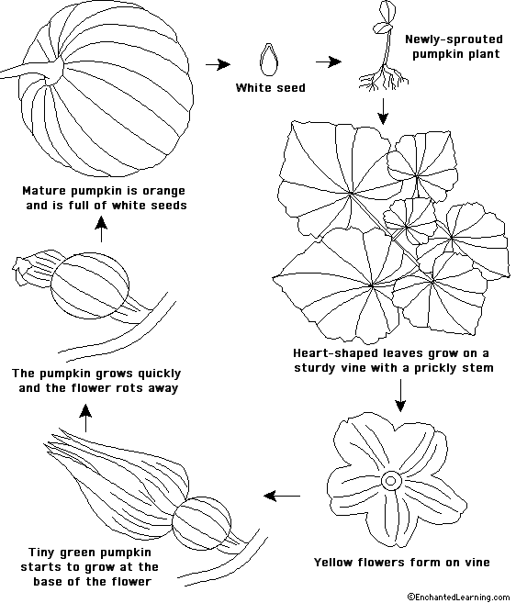
When the snow melted and winter was over, what did Tim find where his pumpkin had once been?
Pumpkins grow on a _____________.
Color the pumpkin flower yellow.
In the spring as it got warmer, what did Tim find where Jack had been. Draw a picture in this box.
Color the new pumpkin green and
the flower yellow.

Slide 43
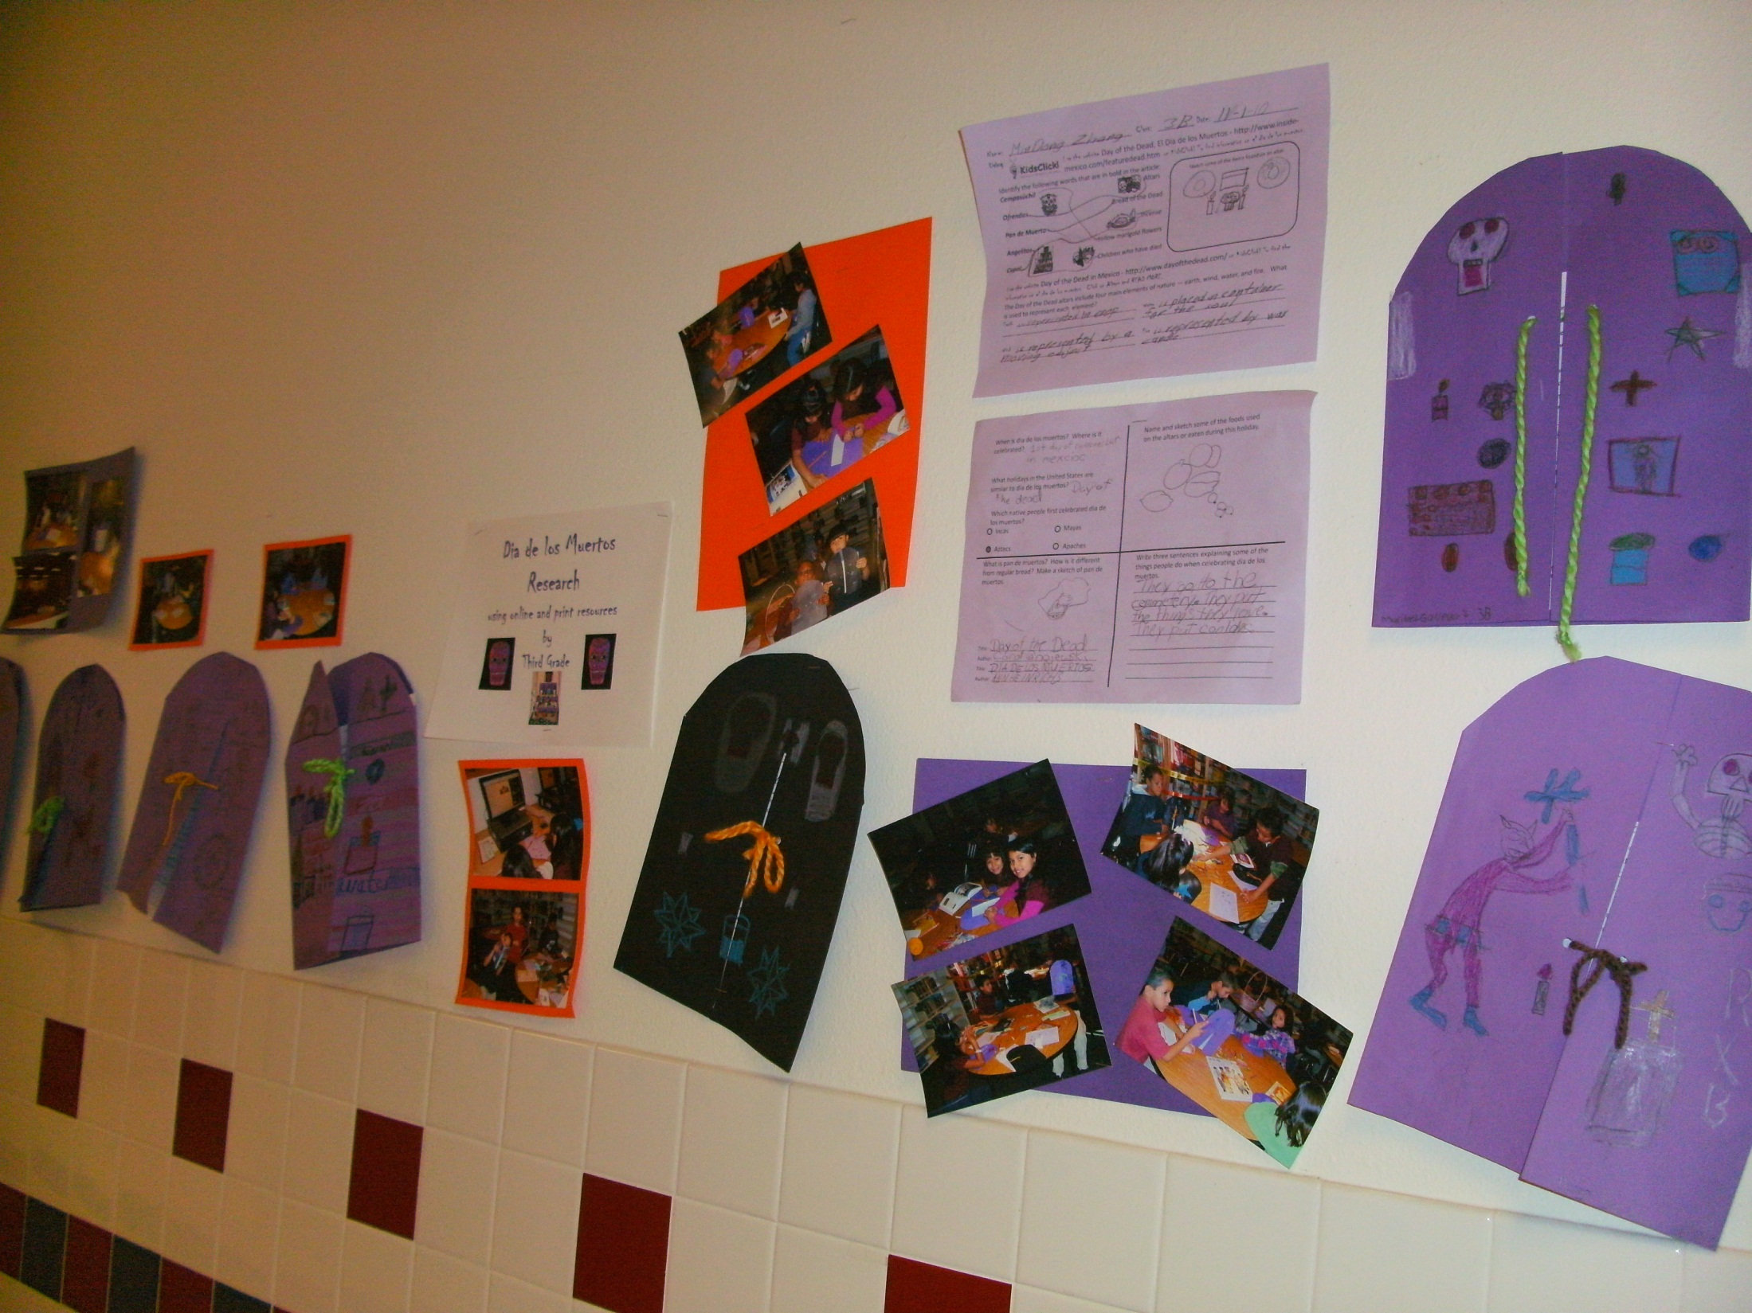
Dia de los Muertos: researching our ancestors’ cultural traditions.
Every child has a binder.

Slide 44


Name: ____________________________ Class: ________ Date: __________________
Using
Use the website Day of the Dead, El Dia de los Muertos - http://www.inside-mexico.com/featuredead.htm on KidsClick! To find information on el dia de los muertos.
Identify the following words that are in bold in the article:
Cempasúchil Altars
Ofrendas Bread of the Dead
Pan de Muerto Incense
Angelitos Yellow marigold flowers
Copal Children who have died
Sketch some of the items found on an altar.
Use the website Day of the Dead in Mexico - http://www.dayofthedead.com/ on KidsClick! To find the information on el dia de los muertos. Click on Altars and READ MORE.
The Day of the Dead altars include four main elements of nature — earth, wind, water, and fire. What is used to represent each element?
Earth _____________________________________ Water ___________________________________
_________________________________________ ________________________________________
Wind _____________________________________ Fire ____________________________________
__________________________________________ ________________________________________

Slide 45
When is dia de los muertos? Where is it celebrated?
Name and sketch some of the foods used on the altars or eaten during this holiday.
What holidays in the United States are similar to dia de los muertos?
Which native people first celebrated dia de los muertos?
Incas Mayas
Aztecs Apaches
What is pan de muertos? How is it different from regular bread? Make a sketch of pan de muertos.
Write three sentences explaining some of the things people do when celebrating dia de los muertos.
________________________________________________________________________________________________________________________________________________________________________________________________________________________________________________________________________________________
Title: ____________________________________________
Author: __________________________________________
Title: ____________________________________________
Author: __________________________________________

Slide 46
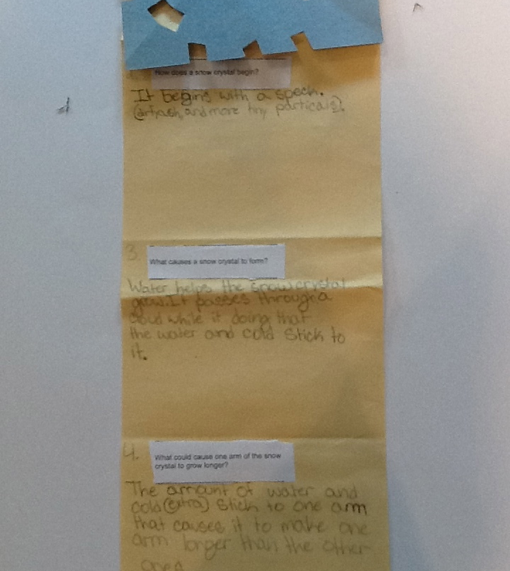
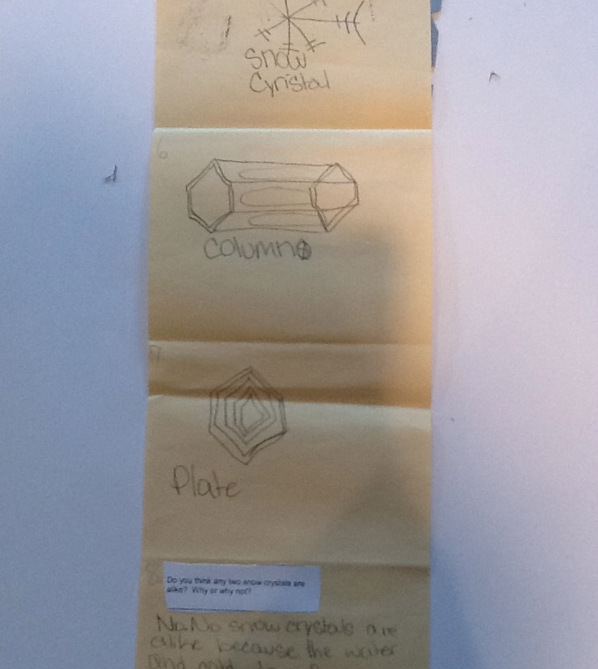
Accordion books with The Story of Snow by Mark Cassino

Slide 47
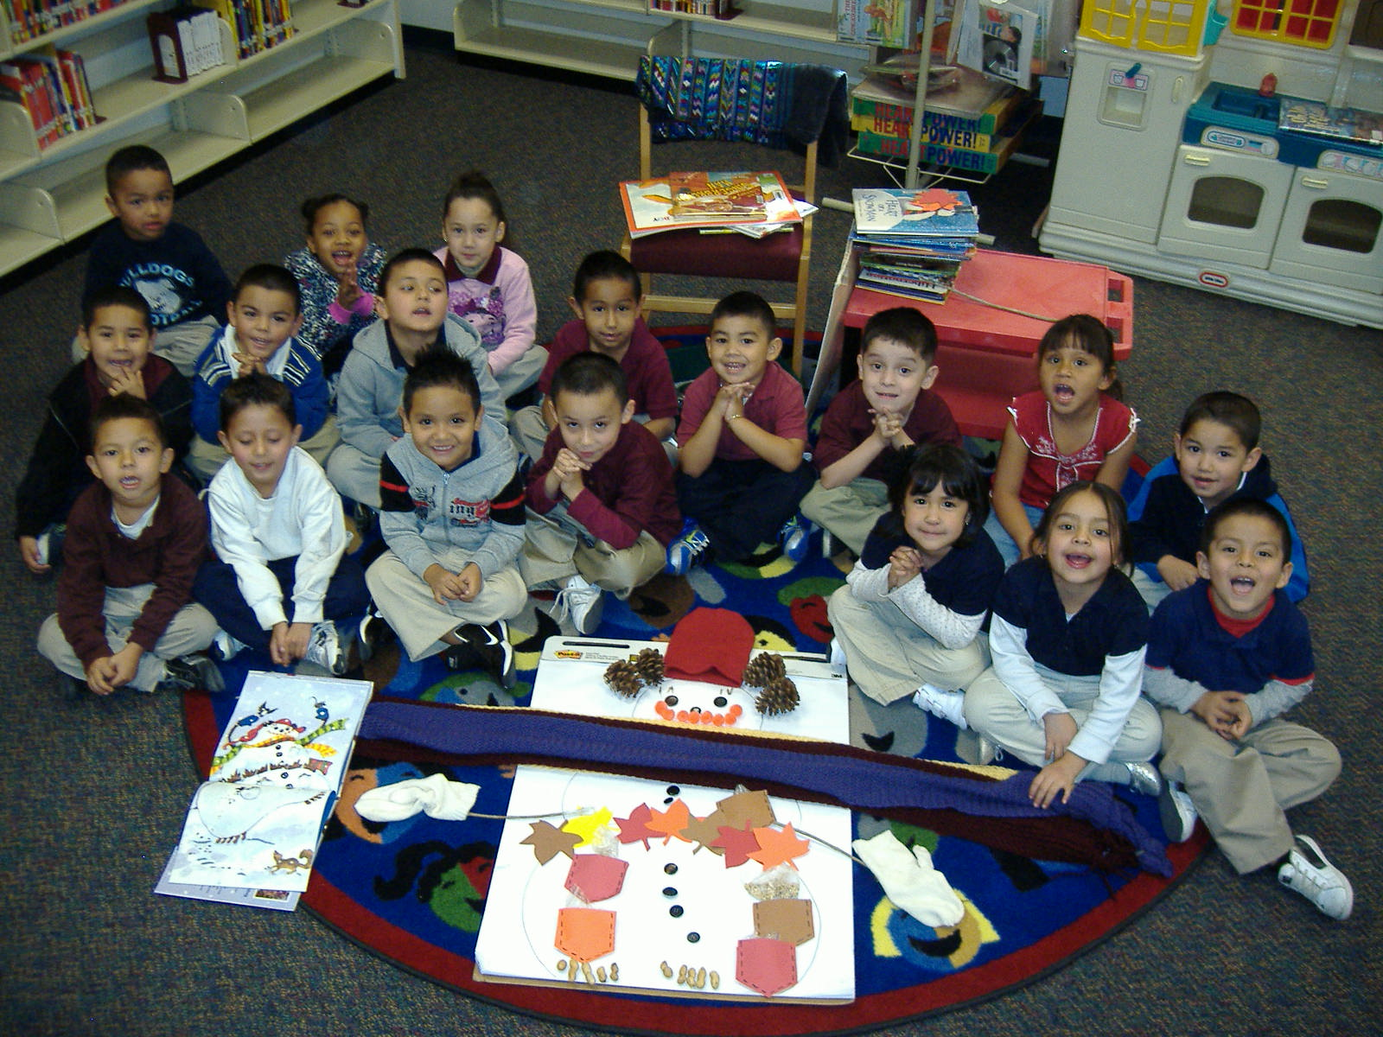
Recalling details by building another snowman like the one in Denise Fleming’s book The First Day of Winter.

Slide 48

Sleepy Bears Hibernate
Polar bears hibernate in the __________________________.
What is a baby bear called?
pup kitten cub colt
How many babies do bears usually have at one time?
One
Two
Three
Draw a picture of a den where a bear might hibernate.
In what season do bears build their dens? ________________ .
In the winter, bears ________________.
During what season do bears leave their dens? _________________________.
hibernate spring fall
What do bears do before they hibernate? Circle your answer.
Read books
Watch TV
Eat a lot

Slide 49

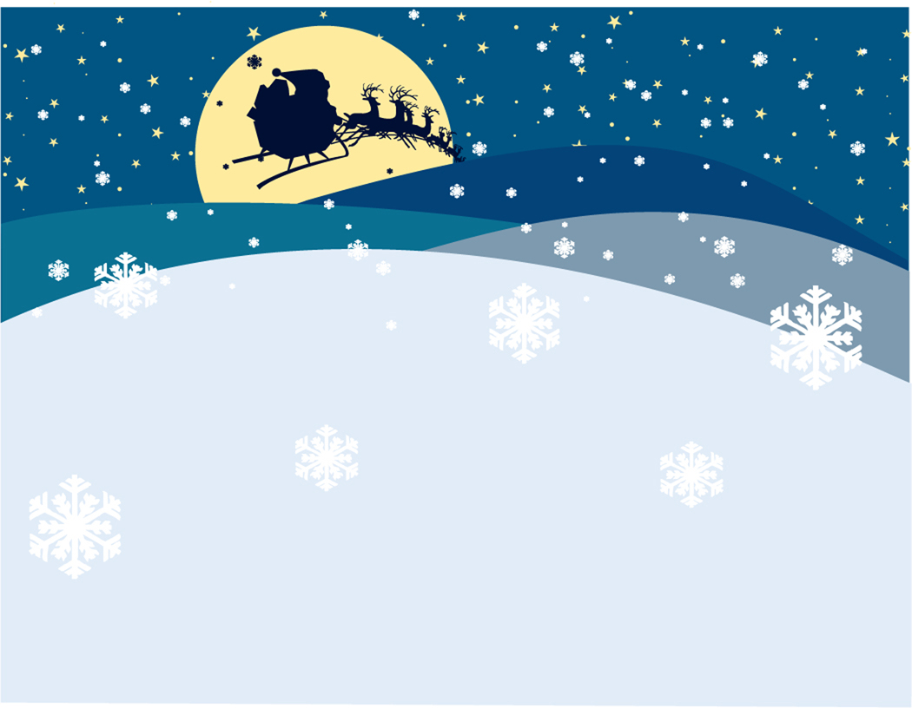
Getting Ready
Hibernation Cycle
Leaving the Den
Finding a Den
Hibernating

Slide 50
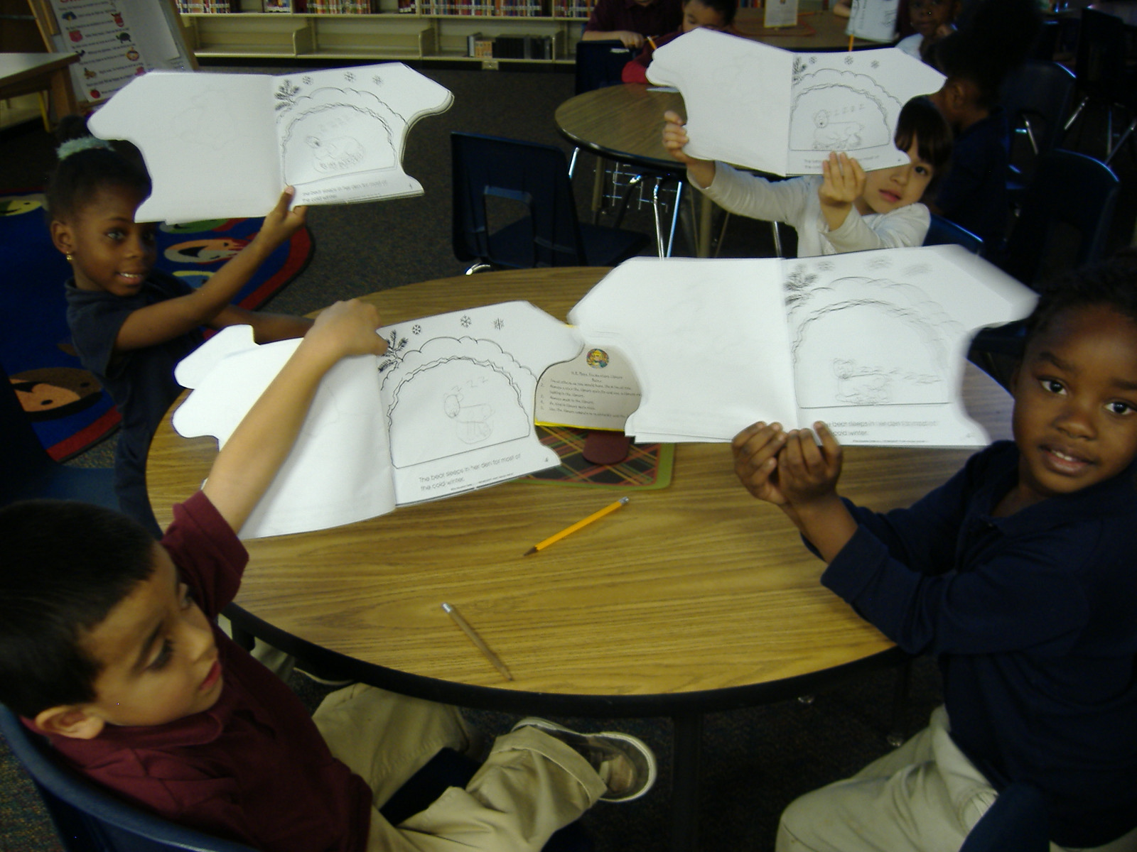
Using sketching as a form of note-taking with “Black Bear’s Winter” booklet.

Slide 51
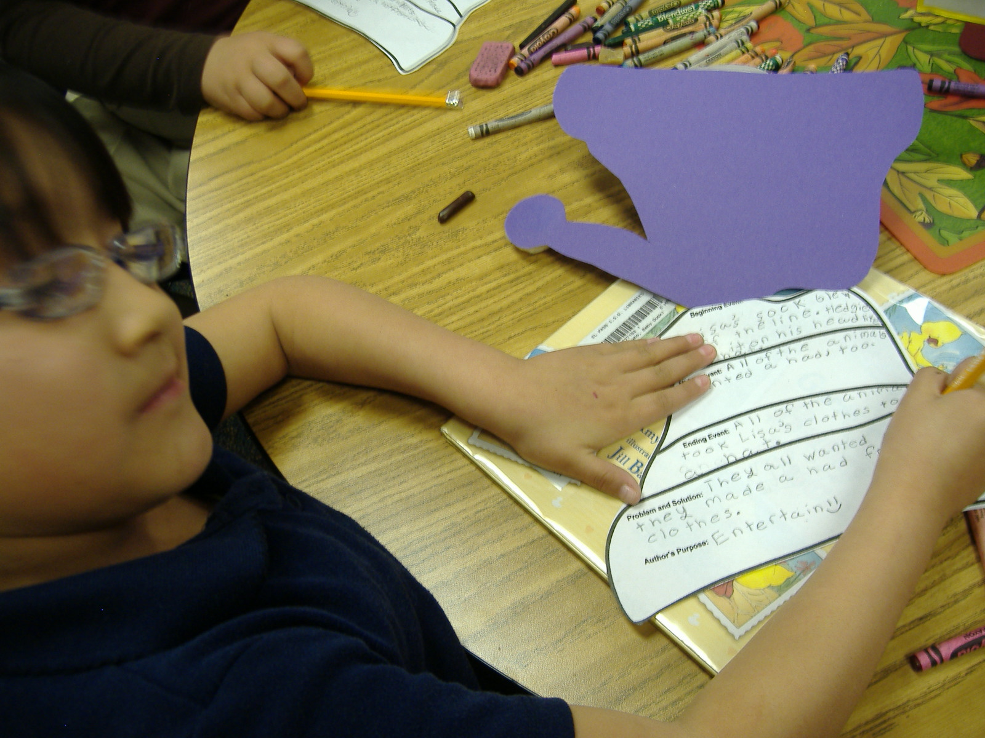
The Hat by Jan Brett sequencing and author’s purpose activity.

Slide 52
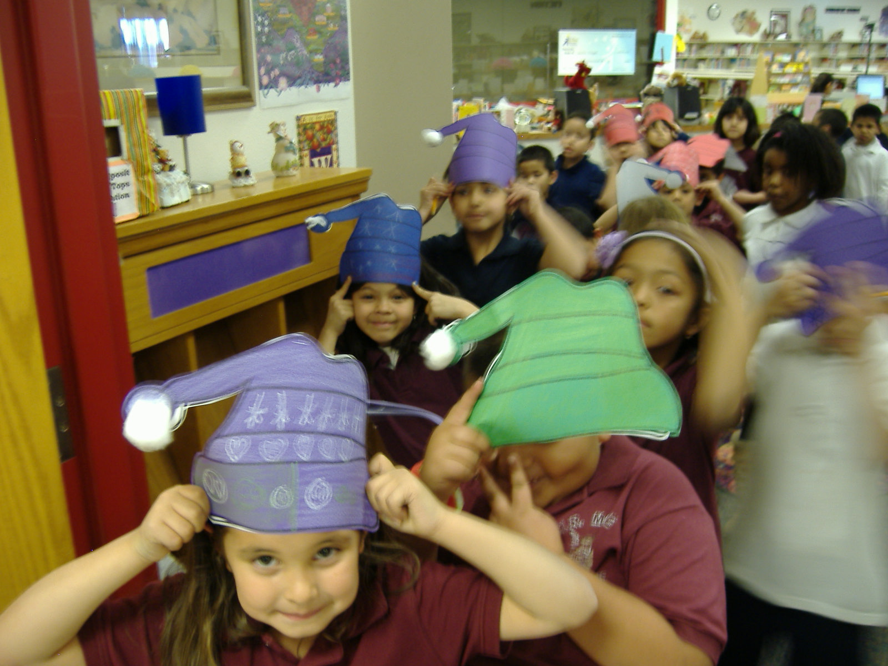
Wearing our hats afterward.

Slide 53
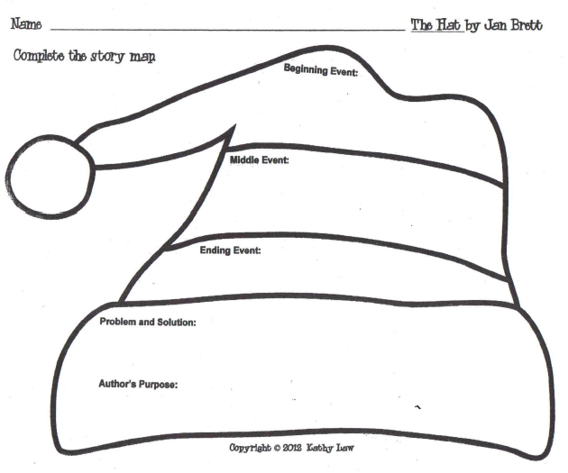

Slide 54
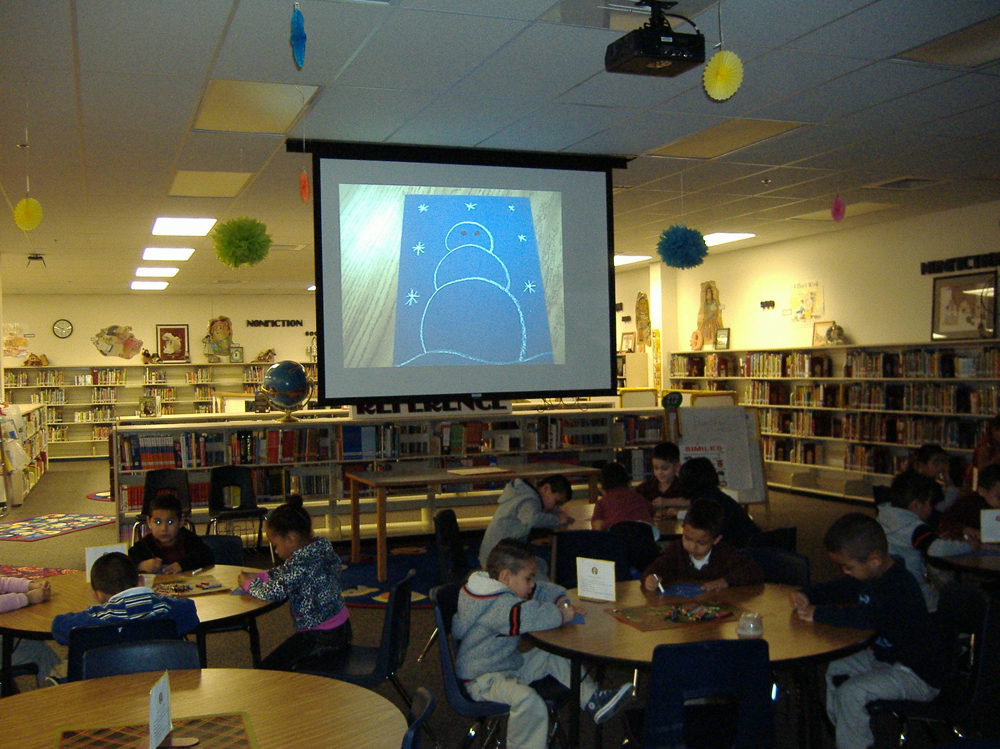
Following directions to build a snowman in El Paso’s desert winter.

Slide 55
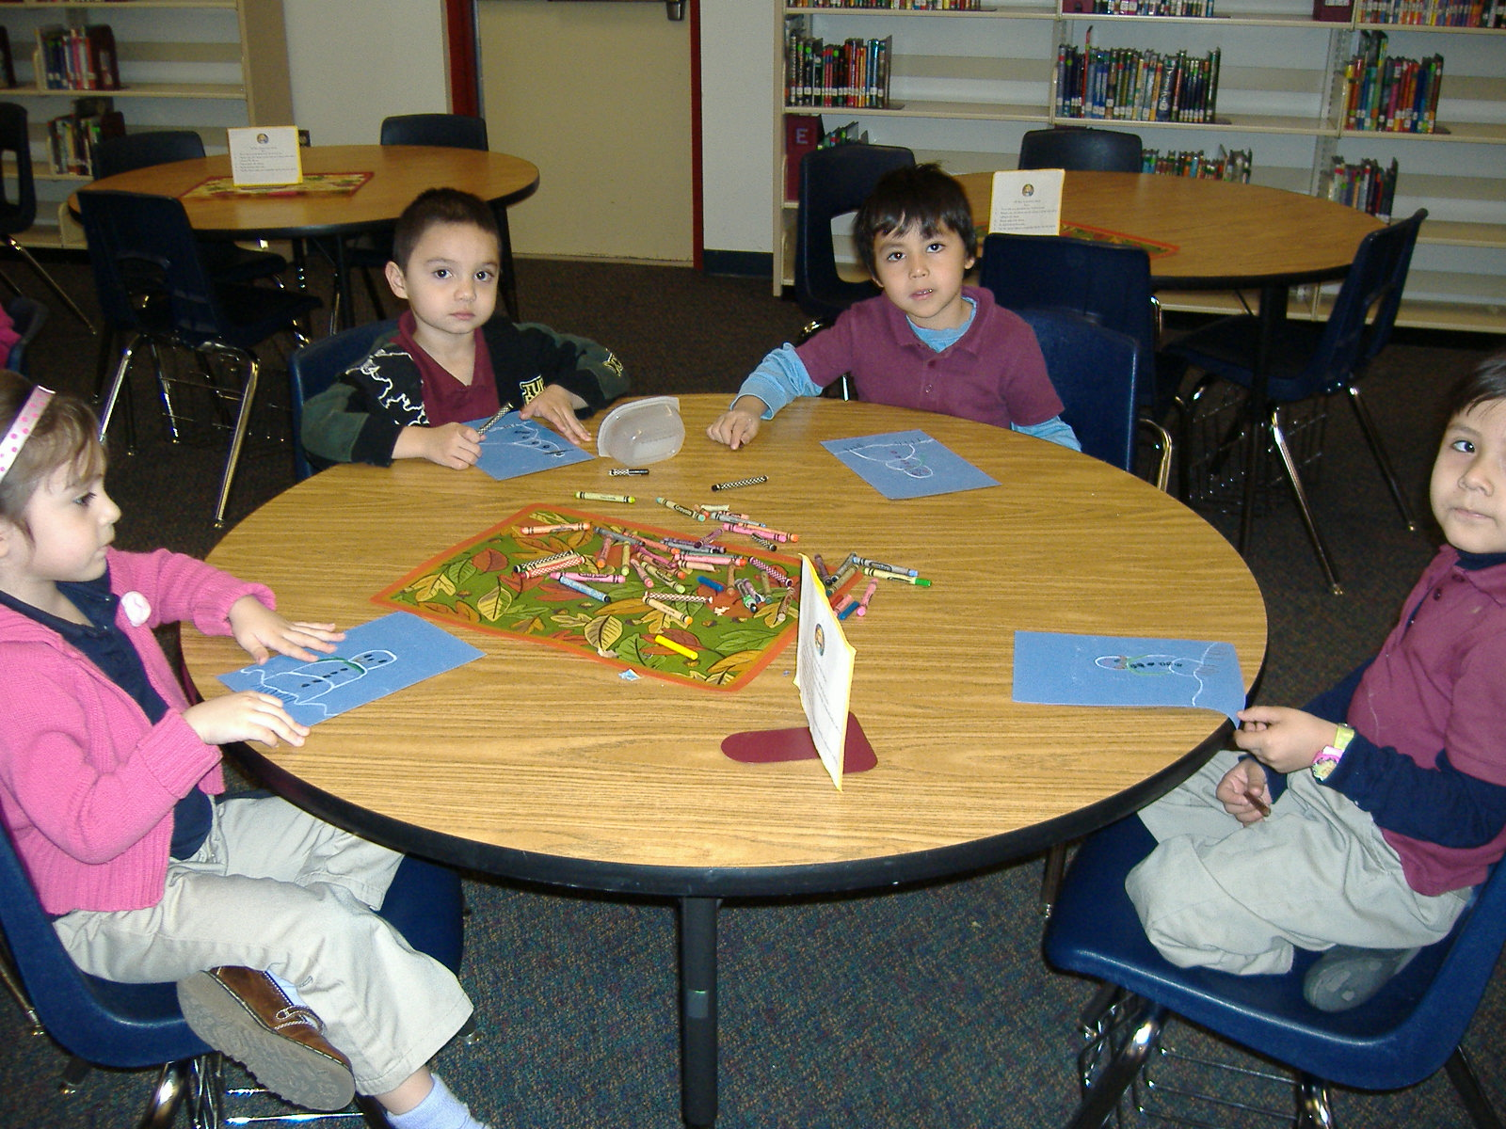
We didn’t even have to get cold.

Slide 56
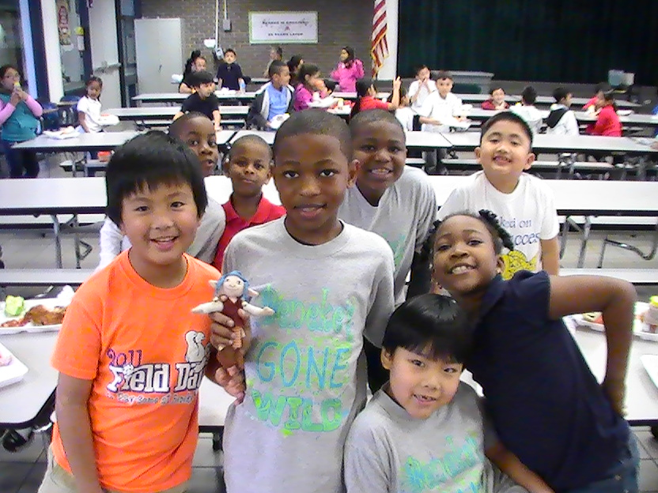
Skoob visits Beneke
Judy Dallinger, librarian in Richland Hills, Texas shares Skoob.
Skoob Visits Beneke Elementary
And Valerie meets Jackie Mims Hopkins.

Slide 57

Skoob, the shelf elf’s second annual visit to Moye.

Slide 58

Skoob and his grandpa make doughnuts and send valentines before they go.

Slide 59


Slide 60

Name:
2
Date:
This is what Skoob did in our class today:
__________________________________________
______________________________________________
2. __________________________________________
______________________________________________
3. ___________________________________________
______________________________________________
4. ___________________________________________
______________________________________________
Skoob
the
Shelf Elf
Word Bank
cafeteria , breakfast , lunch , P.E. , gym, recess, science lab, computer lab, library, nurse, reading, writing, math, language, Spanish, uniforms, lunch tray, alphabetical order, AR, I-Station, Pledge of Allegiance, announcements, flag, pencil, flag-tag, dodge ball, attendance, counselor, friend, teacher, mountain lions, school, H.R. Moye, social studies, text book, dictation, centers, journal, calendar, spelling

Slide 61
Draw Skoob!
Name two things your remember about Skoob’s activities at the school in Richalnd Hills, Texas.
1. _________________________________________________
_____________________________________________________
2. __ _________________________________________________
_____________________________________________________
Describe El Paso to the children who Skoob will be visiting.
______________________________________________________________________________________________________________________________________________________________________________________________________________________________________________________________________________________________________________________________________________________________
Word Bank
sunny, desert, mountains, cactus, dry, little rain, cool winters, hot summers, sunsets , animals, languages, El Paso is near what country?, What shape is in lights on the mountain? What university is here?

Slide 62

Character analysis foldable for Horton Hatches an Egg by Dr. Seuss.

Slide 63

Research on Dr. Seuss using Britannica Online and Ebsco.

Slide 64

The Cat in the Hat’s
Thing 1 and Thing 2.

Slide 65

“How to Blow a Bubble” procedural writing with Meghan McCarthy’s book Pop! The Invention of Bubble Gum.

Slide 66


Sequencing the steps to blowing a bubble.

Slide 67


Blowing Bubbles

Slide 68

Three successful bubble blowers.

Slide 69

An entire class of bubble blowers!

Slide 70


Slide 71

Dogzilla by Dav Pilkey and The Mightiest Heart by Lynn Cullen to help us understand tone and mood.

Slide 72

Dog-eared foldable.

Slide 73

Name_______________________________________
Section_1_A B C D E F G_
Draw a around the season when animals hibernate. Draw a around the season when animals wake up.
spring
summer
fall
winter
Write three words to describe the
weather in the spring.
A
B
C
Which thermometer illustrates temperatures
during the spring season?
A B C

Slide 74
Draw three things that Bears wants to
eat in the book Bear Wants More! by Karma Wilson.
Use pictures in your nonfiction season book to help you draw a picture of the weather during that season.
In our library, we put stickers on the spines of the holiday books to make it easier to find them on the shelf. Draw a picture of the stickers we use for Easter books and for St. Patrick’s Day books. We celebrate these holidays in the S P __ __ N ___ .
My book:
Title: _______________
___________________
___________________
Author: _____________
___________________
St. Patrick’s Day books Easter books Spring books

Slide 75

Identifying and selecting best resources for research.

Slide 76

Evaluating the best resource.

Slide 77

Plant worksheets and foldables.

Slide 78

Learning about plants with the Center for Puppetry Arts.

Slide 79

We learned how to “grow” a plant puppet.

Slide 80
Name: __________________________________________ Class and section: _________
Teeny Tiny Seeds
Plants make seeds and a new plant can grow from each ___________________________.
What three things do seeds need In the box below, please sketch and label a seed to be able to grow? opening in the soil.
_______________
_______________
_______________
Fill in the missing letters to spell
these parts of a plant:
S e ___ d S t ___ m
R o o ___ s ___ o d
F l o ___ e r L e ___ v e s

Slide 81

In the box below, please draw three ways seeds can be spread.
The parts of the book I found in my book are:
Index Glossary Table of Contents Title Page Map Captions Internet Sites
More to Read/Bibliography
This is the book I used for my research:
Title: _________________________________________________
Author: _______________________________________________
Call number: __________________________________________

Slide 82

Life in a … studying biomes.

Slide 83



Slide 84


Regions of the World

Slide 85

Animal research using print and online resources.

Slide 86

Lions, tigers and rhinos – oh, my!

Slide 87

Learning to use online resources. We love PebbleGo.com.

Slide 88

Animal pop-up foldable with information from print and online resources. Who knew…giraffes have blue tongues!

Slide 89


Animal research using print resources.

Slide 90

Penguin research using print and online resources; 3-D habitat diorama.

Slide 91




Name: _________________________________________ Penguins Date: ____________________________ Class: ________
I am researching the ____________________________ penguin.
How many eggs does your penguin lay?
____________________________________________________________________________________
Please list four kinds of penguins.
______________________________
______________________________
______________________________
______________________________
Write the height of each penguin on the line below its picture.
African
______ to ______feet tall
Circle your answers. My animal has:
Flippers
Sharp teeth
Fur
Short legs
Feathers
Four feet
Orange feathers on their ears
A long tail
Webbed feet
A beak
Adelie
______ feet and ______ inches tall
Emperor
Almost ______ feet tall
King
______ feet tall

Slide 92


What does your animal eat? ____________________________________________________________________________________________________________________________________________________________
Write a sentence that describes how penguins move.
___________________________________________________________________________________________________________________________________________________
Write an interesting fact about your penguin.
___________________________________________________________________________________________________________________________________________________
In the rectangle above please draw your penguin in its habitat. Add details to your picture to show where your animal lives.
My resource
Title: ___________________________________________________________________________________________
Author: ___________________________________________________________Call number: ___________________

Slide 93


Animal habitats
Research in the library, taking notes, sketching notes and translating that into TELPAS writing.

Slide 94

Animal habitats using jigsaw puzzle pieces to create a final product.

Slide 95


Slide 96


Slide 97




The Water Cycle
Name:______________________________________________________ Section: ___________________
A cycle has no beginning and no _______________________ .
The heats the . The heat from the sun changes the
water. The water changes from a liquid to a vapor or a _________________ . This is called
__________________________. The water vapor cools as it ___________________. It
forms and becomes a liquid again. It falls back to earth as .
Use these pictures and words to fill in the blanks:
gas rises end evaporation

Slide 98

The itsy bitsy
Climbed up the .
Down came the and washed the out.
Up came the and dried up all the .
And the itsy bitsy climbed up the again.

Slide 99
Name:____________________________
Exploring the Universe
with Encyclopedia Britannica,
StarChild and KidsAstronomy.com
Section:_________________
This planet was discovered in ________________ .
The name of my planet is ________________________ .
Where does this planet’s name come from? _______________________________________________________
__________________________________________________________________________
____________________________________________________________________________________________________________________________________________________
Label the planets in our solar system.
SUN
My planet is ______________________
miles from the sun.
My planet is bigger OR smaller than Earth. (circle one)
Write two sentences that describe the way this planet looks and what it is made up of. _____________________________________________________________________________________________
____________________________________________________________________________________________________________________________________________________________________________________________________________________________________________________________________________________________________________________________________________________________________________________
My resources:
Website: ___________________________________________________________
Book Title: __________________________________________________________ Author: _________________________________

Slide 100










Three statistics (number facts) about my planet are:
_______________________________________________________________________
__________________________________________________________________________
__________________________________________________________________________
_______________________________________________________________________
__________________________________________________________________________
__________________________________________________________________________
3. _______________________________________________________________________
__________________________________________________________________________
__________________________________________________________________________
The images circled below represent characteristics of my planet.

Slide 101
Research on Soil
using print and online databases
Use the dictionary on Encyclopedia Britannica Online to find a definition for soil. Please write the definition in your own words on these lines: _______________________________________________________
___________________________________________________________________
___________________________________________________________________
A layer of soil is called: ___________________ .
Draw and label the layers of soil in the rectangular shape.
Soil provides a place for plants to _____________ . The pores in soil hold water and ______________ in place for their roots. Soil contains _________________ that plants need to grow. Many animals and other living things make their ________________ in soil. Soil forms very ________________ . It can take hundreds of years to form a layer that is ____________ inch foot meter (circle one) deep.

Slide 102
Sketch pictures that illustrate how soil forms:
+
= soil
Mineral part
Organic part
Write two sentences that explain ways that soil can be destroyed.
____________________________________________________________________________________________________________________________________________________________________________________________________________________________________________________________________________________________
Use Buzzle.com to identify the different types of soil. Write the types of soil on the lines below. Circle the type of soil that is found in El Paso. Draw a rectangle around the type of soil that is best for growing plants.
_______________ _______________ _______________ _______________
_______________ _______________

Slide 103




Movies used to support biography research by upper grades.

Slide 104

Butterflies for the Houston Holocaust Museum made by fifth grade during a study of Anne Frank.

Slide 105
Name: _______________________________________________ Class Section: _________
Sadako Sasaki
Use Encyclopedia Britannica and the biography about Sadako for the answers to the following questions about Hiroshima. The following words in the WORD BANK can be used to fill in the blanks.
WORD BANK
70,000 Peace Memorial Park crane August 6, 1945 radiation Atomic Bomb Dome Japan statue 1,000 October 25, 1955 well classmates money
In what country is Hiroshima located? ____________________ On what date was Hiroshima bombed by the United States? ____________________ More than ____________________ people were killed immediately by the atomic bomb. Many other people died later from the ____________________ left after the bomb exploded.
The people of Japan have built a park in the location where the bomb was dropped to honor the victims who died from the explosion. It is called _________________________ . In the center of the park is a building called the _________________________ that was partially destroyed by the bomb. There is also a ____________________ of Sadako holding a golden ____________________ .
While Sadako was in the hospital, her friends and family had helped her make origami paper cranes. An old Japanese folk tale says that cranes live for ____________________ years and if a sick person folds a thousand paper cranes, the gods will make him ____________________ again. Sadako died on _________________________ before she had folded all of her cranes. Her ____________________ folded 356 cranes so Sadako could be buried with one thousand. Children throughout the country collected ____________________ to build the monument for Sadako and all of the children killed by the bomb.

Slide 106

Use EbscoHost Searchasaurus to find
the answers to the f ol following questions.
In the box below write the words that are
carved on the bottom of the statue of Sadako.
This is
This is
Peace
Sketch Sadako’s statue.
What surrounds the Sadako’s statue?
__________________________________________________
(折鶴
This is the Japanese word for crane. Please write this word in Japanese in the bubble to the right.
http://thedesigninspiration.com/articles/won-park-the-master-of-origami-paper-folding/
http://www.hardin.k12.ky.us/japan/orig_crane.htm

Slide 107

Following the drinking gourd to learn about Harriet Tubman; making graham cracker quilts.

Slide 108

Aunt Harriet and the Underground Railroad in the Sky by Faith Ringgold + Britannica Online = a successful lesson.

Slide 109
Name: _______________________________________________________________ Class section: ____________
Harriet tubman
Add the dates of Harriet Tubman’s birth and death to the timeline below. Add three more important dates in her life to the timeline.
Birth Date Date Date Death
Use Britannica Online and the Word Bank to fill in the blanks:
mother’s John Tubman slave eleven Maryland 300 Araminta Ross 1913
Pennsylvania Underground Railroad parents school nurse
Harriet Tubman was a runaway ____________ . She led more than ____________ slaves to freedom which earned her the nickname the Moses of her people. Harriet was born in ____________ . Her real name was ________________________ but she changed her name to Harriet, which was her ____________ name. There were ____________ children in her family.
In 1844, Harriet married a free African American named _________________________ . Several years later, she escaped to Philadelphia, _____________ without her husband after learning that she was going to be sold to a new master. Once Harriet was free, she used the ______________________ to lead her ____________ and hundreds of other slaves to freedom.
During the Civil War, Harriet returned to the south with the Union Army. She worked as a scout and a ____________ to help the soldiers of the north win the war. When the war was over, she moved to New York with her parents. She opened a ____________ for African American children and worked for equal rights for women. Harriet Tubman died in ____________ . She was 93 years old.

Slide 110

Use books on the Underground Railroad, Harriet Tubman and Sojourner Truth to define these words:
Plantation: ____________________________________________________________________
____________________________________________________________________________________
Bloodhound: __________________________________________________________________
____________________________________________________________________________________
Fugitive: _______________________________________________________________________
____________________________________________________________________________________
Quakers: ______________________________________________________________________
_____________________________________________________________________________________
Safe houses: ___________________________________________________________________
_____________________________________________________________________________________
The slaves often used the stars to guide their way on the Underground Railroad. They sometimes sang about The Big Dipper and called it The Drinking Gourd.
In the box, please illustrate something you learned about from the books you used. Maybe a quilt, or a safe house, or the drinking gourd or the north star.
Write the title and author on the lines below.
Title: _________________________________
_____________________________________
Author: ______________________________
_____________________________________

Slide 111


Name: Class:
Helen Keller
Add the dates of Helen Keller’s birth and death to the timeline below. Add three more
important dates in her life to the timeline.
Birth Death
How did Helen Keller become blind and deaf?
She was in an accident and lost her sight and hearing.
She was born blind and deaf.
She became sick and her lost sight and hearing.
She lost her sight and hearing in her old age.
Because Helen could not talk when she became blind and deaf, she could not tell her parents what she wanted or how she f______________. She was a very a______________ little girl. As a child, Helen did not behave very well. Helen’s parents visited many doctors trying to get help for their little girl. One of the doctors they visited was Dr.______________________________. He invented the t_______________ and taught deaf children how to speak. He helped the Kellers find a t_______________ for Helen. A_______________________ became Helen’s teacher. Annie taught Helen how to talk with her h_______________. She used her f_______________ to spell words into Helen’s hands. When Helen got older, she learned to read using an alphabet called B_______________. This alphabet was created by L_______________________ and is made up of little raised bumps on a page. Blind people feel the little bumps with their fingers in order to read. With her teacher’s help, Helen learned how to r_______________ and w_______________ and became very famous. Helen Keller has been an inspiration to many people.
Word Bank
read write felt telephone hands Braille Annie Sullivan
Louis Braille teacher angry
Dr. Alexander Graham Bell fingers

Slide 112
The first word that Helen learned from Annie Sullivan was water. Annie spelled the word with her fingers into Helen’s hand then put her hand under running water. Suddenly Helen understood that the Annie was using her hands to spell out words. Draw a picture of the finger spelling letters for the word W A T E R.
W A T E R
Use the Braille alphabet and numbers to write your name and your birthdate in the box below.
What important lesson can we learn from Helen Keller? ________________________________________________________________________________________________________________________________________________________________________________________________________________________________
Bibliography
Title:_______________________________________________________________________________
Author: _________________________________________________ Call number: _______________

Slide 113


Slide 114

H.R. Moye Accelerated Reader Store

Slide 115

Excited to receive our Little Free Library from fellow El Paso ISD librarian, Lisa Lopez.
You can have one, too.
Go to http://www.littlefreelibrary.org/

Slide 116

Making posters to advertise our Little Free Library.

Slide 117

Our last year of RIF…thanks for the memories and the books!

Slide 118
3D Graphic Organizers by Daniel J. Barnekow
Library Research with Emergent Reader by
Christa Harker and Dorette Putonti
Mentor Texts:
Teaching Writing through
Children’s Literature
AND
Mentor Texts: Teaching Informational Writing through Children’s Literature both by Lynne
Dorfman and
Rose Cappelli

Slide 119

Visit us at:
Leslie Clingan
http://hrmoyelibrary.weebly.com/
http://moyelibrary.blogspot.com/
Valerie Price
http://valprice.edublogs.org

